Slide 1

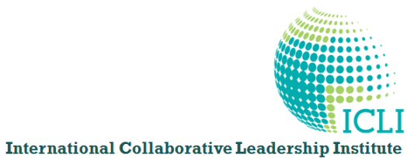
In the nearly twenty years since ASAP’s founding, the world has embraced alliances, collaboration, and interconnected eco-systems as normal and valuable.
The word “alliances,” which used to be shunned and scorned, is now embraced, cherished, and endorsed.
Why, then, are we -- the strongest advocates of alliances -- not seeing more C-Suite recognition for Managing Alliances?
The Road
to the
C-SuiTe
Key Points
  Victims of Self Imprisonment
  Why Thought Leadership is Essential
  What Alliance Professionals Must Do
CHANGE THE GAME
Robert Porter Lynch
RobertLynch@Warrenco.com
Notes:
Story: Dow Corning Chief Deal-Maker, Chief Legal Officer – 2 days could not get into their minds what an Alliance Management System might look like or create value.
Caused a major rethinking in my mind.
I am a Collaboration Champion – What that means: I live in a perpetual state of enlightened dissatisfaction
The Slides are a little busy because I wanted you to have them as a coaching “handbook” to understand how to Shift the Game.
I’m not going to give you the standard speech about the difference between managers and leaders (I gave that speech 15 years ago), nor the standard advice about how to influence the CFO, talk money, etc. (I gave that speech 10 years ago) – You’ve heard that all before, and it obviously hasn’t worked.
Today we take a different journey – fresh new thinking and Changing the Rules of the Game.

Slide 2

Part 1 – Why We Are Stuck
      Mis Alignments Require Shift in Strategy
Part 2 – Game Changing Strategy
      Leading the Collaborative Shift -- Alliances are too Narrow
Part 3 – Shape Shifting Strategy
      New Thinking , Architecture & Mind MAAPS
      - Metrics, Architecture, Actions, Pictures, Stories
Part 4 -- Road to the C-Suite
      What We Must Do
  Alliance Professionals are Positioned for Great Careers
  if……...We Change the Game & the Thinking
The 5 Mistakes that
Cause Self Imprisonment
Shape Shifting
Notes:
MAAPS is the Key – the Five Elements of Mind-MAAPing is critical to changing underlying Beliefs & Perceptions. Mind MAAPS
Determine Beliefs,
Frame Fears,
Perceptions & Thoughts
Values & What is Valued
Rewards & Punishments
Priorities & Possibilities
Changing Mindsets with New Rules of the Game will get people’s attention.
Requires Simple MAAPS

Slide 3
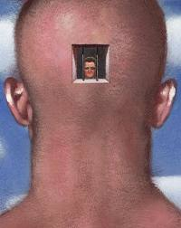
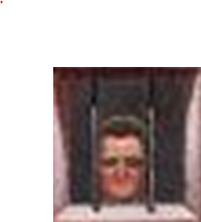

Changes Required
Part 1- Why We are Stuck
Mis Alignments
Thinking
Architecture
& Branding
Need
GAME CHANGER
Fresh New
Tactical
Must Be STRATEGIC
Creating Competitive Advantage
Cost-Driven
Must Create VALUE
that turns into Money
TransActional
Must Empower COLLABORATION
Transactional Deals SubOptimize
Muddled
Must Handle COMPLEXITY
with Collaborative Systems
Protective
Must Be TRUSTED & VALUED
to Influence Without Authority
Managerial
Must Demonstrate LEADERSHIP
being a Manager is Too Small
Notes:
If we are to gain traction, we can’t do the same things, just better. – Definition of Insanity.
The Changes Required are “Elevations of Thinking” – Something Managers don’t do, but Leaders Must Do
We need to change the way people think about Collaboration itself, and the blockages they have.
Protection is limiting – Control is still a big issue, Lawyers and Accountants are the Controllers. Nothing inherently wrong with this, but you must be able to demonstrate a way to REDUCE RISKS by Collaboration.
Legal Agreements & Financial Controls do not create successful collaborations – best practices instituted by leaders do.

Slide 4


Part 2 – Game Changing Strategy
Road to the C-Suite ➔ Change the Game
Leadership is Essential
Shift has Begun
  Who will Lead the Shift ?
    Alliance Professionals?
    Are we Playing too Small & Narrow?
  Changing the Game
  Shift to a More Powerful Position
    More than Alliances ➔ Positioning Ourselves as Value Creators
    From Alliance Management ➔ Collaborative Leadership
    From Best Practices ➔ Collaborative Systems Design
    From Operational Performance ➔ Strategic & Competitive Leverage
Collaborative
Shift
ASAP Professionals
have the Ability…
but do we have
Vision & Drive
to Lead?
Notes:
Alliance Professionals Have the Collaborative Gene
But only a Piece of the Collaborative Architecture
Shift the Game: The Thinking (Beliefs, Perceptions, Ideals, Objectives)
the Architecture, the Strategy, the Positioning, the Rules, & the Tools
Cannot Lead the Shift with Managerial Thinking
We are being caught pigeon-holed and out of position, with too small a vision

Slide 5
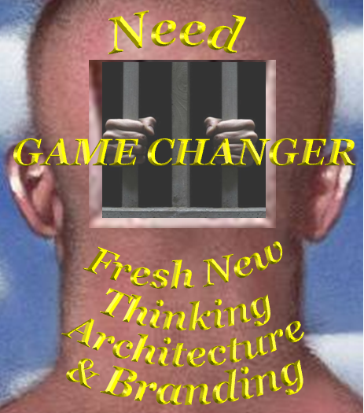



Part 2 – Game Changing Strategy
Alliance Management ➔ Collaborative Leadership Shift
Collaborative Operating System
➔ Better, Faster, More Valuable ⬅
All too Often Alliance Professionals are
Pigeon-holed on Fringe of Corporate Structure
        Sub-optimized Talent
        Should be the Masters of Collaboration
        Bring New Levels of Value to Stakeholders
  ➔Migrate/Imbed in Centers of Power
    Masters of Collaborative Systems Architecture
    Where ever Complexity requires Trust & Teamwork
    --Every Project, Department, Cross-Functional Team, Supply Chain
  ➔ Game Changer Strategy & Architecture
  with Mind MAAPS --Metrics, Architecture, Actions, Pictures, Stories
Collaborative
Leadership
BIG
Picture
Collaboration
Central
Collaborative
Economics
Collaborative
Operating Systems
Collaborative
Teamwork
& Trust
2
ASSOCIATION OF
STRATEGIC ALLIANCE
& PARTNERING
PROFESSIONALS
Collaborative
Strategy
Collaborative
Innovation
Strategic
Alliances .
Key Actions: Advocate & Orchestrator of Collaborative Systems for:
-- Innovation -- Leadership – Teamwork – Competitive Advantage
Key Messages: Collaboration is required for Value Creation Managing Complexity, Adapting to Change, Attracting Partners
Notes:
Part 3 – Big Picture: Alliance Professionals Have the Collaborative Gene, but only a Piece of the Collaborative Architecture
If we cannot convince Senior Executives of the Competitive Advantage of Collaborative Systems, we are going to be boxed in, boxed out, and very frustrated.
Cannot Lead the Shift with Managerial Thinking
Must move from the fringe to the center AND into the Functional Applications
Companies that have embraced alliances have eaten a piece of the pie – taken a sample -- but most haven’t bought the whole pie.
Quick Test: How Many Companies put their Alliances on their Organization Chart
Alliance Professionals are already Hard Wired to be the Centerpiece of Collaborative Systems
Migrate the mindsets, skillsets, and toolsets of alliances into the mainstream of corporate functioning.
We can pull off a Game Changer Strategy NOW because we have the necessary “chess-pieces” to
We can have alliances and partnerships on the OUTSIDE, but Transactional Disease on the inside – we haven’t changed the underlying mindsets and beheaviors
This is BEYOND ALLIANCES – IT’S A SHIFT IN CULTURE, OF COMPANIES

Slide 6




Part 2 – Game Changing Strategy
The Power of Alignments
The key to success in business, and to life really,
is creating aligned interests with smart people.
-- Robert Kraft, owner of the New England
the most successful sports dynasty in history.
Notes:
Alliances are all about Alignments -- So Is LEAEDERSHIP
Alliances – in fact every organizational system (leadership is a system) – can be understood, diagnosed, and its functions improved by looking at the 4 Alignments

Slide 7
Part 3- Shape Shifting ^{minD MaAps}
Metrics, Architecture, Actions, Pictures, Stories
Alliance Management ➔ Collaborative Leadership Shift
Leadership as Aligned System
◆ Strategic Alignment:
    Co-Create an Inspirational Common Vision, then chart an Innovative Strategy that generates a Significant Competitive Advantage and Value Delivery or Improvement over the Competition.
◆ Cultural/Leadership Alignment:
    Leaders build Culture of Trust & Teamwork & Governance that Unleashes & Focuses Human Energy on High Performance & Achieving Strategy.
◆ Operational Alignment:
    Build Coherent Organizational Teams, with Accountability, Measures of Success, Best Processes/Practices & Rewards that produce great results.
◆ Dynamic ReAlignment:
  Innovate/Adapt & Reconfigure/Restructure as results are achieved
  and conditions/situations change
Dynamic Realignment
Adversity
Crisis
Opportunity
Cultural
Alignment
Operational
Strategic
Alignment
Alignment
T i m e
Comp
ion
it
et
C hange
SIMPLE MODEL ➔ Leadership, Metrics,
Alliances, Change Mgmt, Negotiations,
Hi-Performance Teams, Diagnostics
Key Actions: Use the Four Alignments to Design Excellence
Create Internal Alignments & External Alliances
Key Messages: Alliances are “External Teams” built on Trust
Use Alliance Practices to reduce Internal Silos
Notes:
Great Leaders do 4 things Really Well
Ask 20 people about their leadership model, and you will get 20 different answers. This is not based on traits, characteristics, habits, or personality – LEADERSHIP IS A SYSTEM OF ALIGNMENTS
Yes, it’s that simple – Plus the Courage of Your Commitment
The breakthrough here: Most approaches to leadership are based on habits, traits, personality, & characteristics. – this gets everyone stuck, because these are not universal, and often situational .
The 4-Alignments is not based on these – it takes a Systems Approach to leadership, making leadership an inter-dimensional discipline.
Think of your computer as a 4-Alignments system – Hardware, Software, User-Interface, Upgrades
Managers focus primarily on Operational issues – day-to-day; while great leaders emphasize all four dimensions.
TransAlignment is a new word to address the things that have been missing in alliances, mediation, negotiations, long term relationships.
Alliance Professionals have become one-dimensional – focusing on operations – without a model for Multi-Dimensional winning.
This does not obsolete what you already know and do, but adds to your repertoire. It’s appropriate for long-term organizational relationships, it provides important frameworks and tools that can be used in a multitude of situations.
Think of these as the 4 Levers – for shifting any system

Slide 8
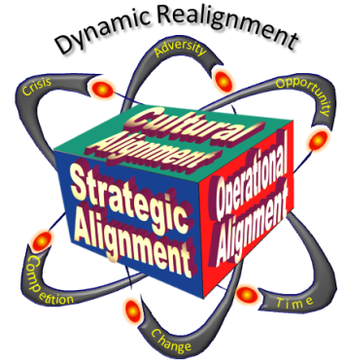
Part 3- Shape Shifting ^{minD MaAps}
Metrics, Architecture, Actions, Pictures, Stories
Alliance Management ➔ Collaborative Leadership Shift
Strategic Alignment
AIM of STRATEGY
Transform Vision & Strategic Assets
Into Value that
creates Competitive Advantage
Quickly & Efficiently
Key Actions: Link & Leverage Strategic Assets across Span of Value Chain
Learn what each Senior Executive can contribute Strategically
Key Messages: Keep Competitive Advantage, Strategy & Speed front & center Alliances are NOT Transactions, NOT Deals, Not Tactical
Notes:
The Aim of Strategy must be your Personal Brand – ASAP’s Brand & Game
What is your Personal Vision & Aspiration
Strategic Assets are not just physical – they are YOUR PERSONAL STRATEGIC ASSETS?

Slide 9

Part 3- Shape Shifting ^{minD MaAps}
Metrics, Architecture, Actions, Pictures, Stories
Alliance Management ➔ Collaborative Leadership Shift
Strategic Alignment
Generate
Competitive Advantage
Battle
and
of
Maximize
Value Flow
Value
End to End (E2E)
in Our Value Chain/Network
Chains
Key Actions: Get Your Supply Chain & Market Strategy Engaged
Get Alignment on Metrics of Competitive Advantage
Key Messages: Must Maximize Flow & Speed of Innovation & Value
Cost is less important than Competitive Advantage
Our Strategic Suppliers
Our Company
Our Partners
Our Ultimate Customers
Notes:
If your company doesn’t have a Value Chain/Network/Eco-System Strategy, it is thinking too narrow
Must Think “Outside the Box” of our own company. First start by “connecting the boxes”
The issue of Value & Value Flow must be addressed
If you don’t shift the Thinking to Value & Competitive Advantage, you will be diminished to Cost and your Value will be Questionable. – the next slide shows why we have been stuck in an ARCHAIC VALUE Paradigm

Slide 10
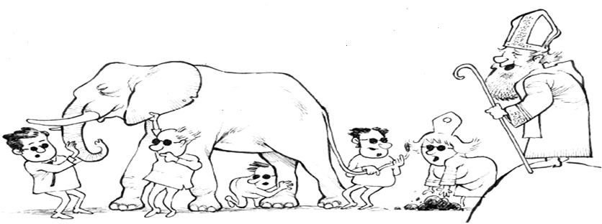
Value Elephant in the Room
Part 3- Shape Shifting ^{minD MaAps}
Metrics, Architecture, Actions, Pictures, Stories
Alliance Management ➔ Collaborative Leadership Shift Strategic Alignment
Go Forth Professors –Analyze evidence;
Cite your sources; Give us expert advice
It’s a
Carpet!
It’s a
Snake!
VALUE
It’s a
Rope!
It’s a
Turd!
It’s a
Tree!
Law
Ops
Supply
Mktg
Business Schools
Fin
Key Actions: Focus Thinking, Language & Metrics & TRAINING on Value Generation
Use Strategic Return on Investment to help focus Value Metrics
Key Messages: Purpose of Business: to Maximize Value Alignment for Stakeholders
If Value is Vague, everything Defaults to Cost or Revenue + MisAlignment
Notes:
Let’s be straight – Business Schools have done an ATROCIOUS Job wrapping their arms around VALUE. So they’ve skirted the issue, focusing on everything else. And our profession has fallen on its face by not inventing a Value Architecture that can carry us forward.
This is a simple but Revolutionary idea – the Big Picture that’s been missing since the beginning of Capitalism on the trade routes of the Egyptian era – commerce that was based on trading, bargaining, and exchange, not creation of value – which the Greeks really mastered, but economics never grasped. Marco Polo’s “trading” is the basis of commerce – commercial thinking & economics. We are stuck in a Middle Ages Time Warp – It’s High Time to break loose! – The next Slide shows where to start
Without Value Alignment, not only does everything default to Cost or Revenue, but Misalignment causes the stakeholders in the Value Flow to go crossways – Investors against Management against Employees against Suppliers (Milton Friedman & Agency Theory – The purpose of Business is to create Shareholder Value.
WE ARE PUMPING OUT 100,000 MBAs a YEAR – GIVING THEM MUDDLED THINKING ABOUT BUSINESS & COLLABORATION – If you want to CHANGE the GAME, you’ve got to change the thinking of management – this means ReTRaining – their learning is OBSOLETE..
Must fill the Value Vacuum – don’t wait for the business schools -- We need to get out in front of this – Value Maximization

Slide 11
Part 3- Shape Shifting ^{minD MaAps}
Metrics, Architecture, Actions, Pictures, Stories
Alliance Management ➔ Collaborative Leadership Shift
Strategic Alignment
VALUE PROPOSITION
VALUE DRIVERS
VALUE STRATAGEMS
VALUE
MAXIMIZATION
VALUE DELIVERY HIERARCHY
STRATEGIC VALUE METRICS
STRATEGIC
COST➔VALUE
MANAGEMENT
VALUE CHAIN COMPETITIVENESS
VALUE CREATION
& FLOW
Key Actions: Master the Disciplines of Value Maximization & Teach Them
Be sure C-Suite, Legal & Finance are on board with Value
Key Messages: Never Learned Value Max in Business School – Should Have! Take Charge of Value Paradigm – Don’t let it default to Cost/Revenue
Notes:
Executives espouse Value, put seldom actually have a structured discipline about how to create value.
Value Maximization is a Discipline – an integration of key value elements. It must be part of your team’s core thinking – and mastered by senior management. It should have been part of Business 101 – so anyone who is just “good” at Value Max Thinking is better than everyone else.

Slide 12


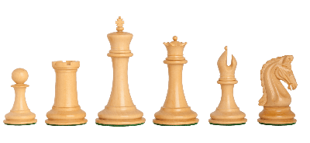
Part 3- Shape
Shifting ^{– Mind MaAps}
5. Value Creation Strategy
Obsolete
the Competition
4. Value Addition Strategy
VALUE DELIVERY HIERARCHY
Out Perform
the Competition
5-7 Key Stratagems Per Step
Cost ➔ Value Shift
Adversarial⬅Transactional➔CollaborativeShift
3. Value Transaction Strategy
Out-Deal the Competition
Potential Value Contribution
VALUE
Maximization
STAIRWAY
2. Value Protection Strategy
Protect Against
Predators
1. Value Depreciation Strategy
Win at All Costs
or Win without Creating Value
Integration Required
Key Actions: Assign % of Strategic Actions for Each Level – Make % Visible
Learn the Key 5-7 Stratagems to Execute at each Levels
Key Messages: Value Maximization is the “Game Book” for Winning
Differentiate Three Cultures (ATC) & Their Impact
Notes:
Don’t get trapped into trying to Define Value – this is situational (like in football) and varies based on your strengths, assets, and the other side’s needs. The Value Stairway shows you the basic moves on the chessboard.
Pay attention to the last double arrow – Adversarial – Transactional – Collaborative because this is the culture Paradigm that is Implied/Implicit but NOT EXPLICIT in your company – and driving you and everyone else CRAZY
Where is the KING? Stay Tuned
Story of Dow-Corning – Chief Deal Maker and Chief Legal Counsel – spent 2 days with them – pulled out every fancy slide, every magic trick, every titillating story, every example I could muster – and I still didn’t get through. Why? Because they were in modes 2 (lawyer) & 3 (deal maker). I then sat down with Steve Rogers and mapped out this new thinking, (I’m sure if the CFO was with us the problem would have been exactly the same.

Slide 13
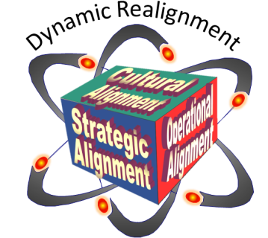

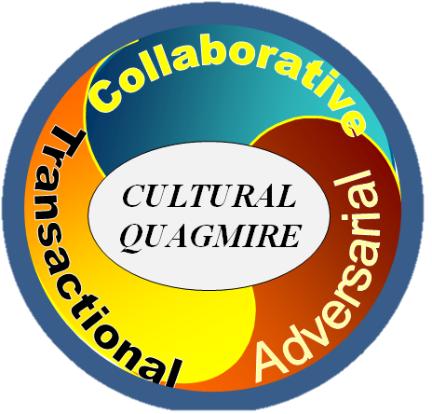
Alliance Management ➔ Collaborative Leadership Shift
Cultural Alignment - Operating System
Three Fundamental Ways of Interacting
Use in Complex, Changing, Innovative, Interconnected Systems
Collaborative
Value Creation
Transactional
Value Exchange
Adversarial⬅Transactional➔Collaborative
Use in Simple, Highly Repetitive, Stand Apart
Competitive Systems
Adversarial
Value Depreciation
BEWARE!
Muddled Culture
Generally Avoid
Zero-Sum Game
Culture
is KING
Key Actions: Master the Strategies & Practices of Collaborative Value Creation
Leaders Focus Time & Energy on Culture – Mindsets/Beliefs drive Action
Key Messages: Never Operate Alliances in the Lower Zones or with Muddled Mindsets
Transactional Deal-Making Mindsets undermines Alliances & Complexity
Notes:
`-- just like a computer’s Operating System (PC, Mac, Linux, etc) it determines how the
manage the company’s (computer’s) Assets & Resources, such as the human resources, assets, structures, key functional areas, inputs, and outputs, (hardware)
establish a user-interface, (the Culture) especially how people perceive their realities, interact with others, understand their roles, priorities, rewards, punishments, (user) and
execute Functional Operations -- and provide services for applications and functions, such as operations, customer service, delivery of products, research, etc. (software)
Learn How to Distinguish the Mindsets & Preferences of Senior Mgmt
Many Companies are “Tri-Polar” -- Some of Collaborative, TransActional, Adversarial – imbedded in pockets controlled by specific individuals whose nature or training is inherently of this style.
Leaders focus a lot on Culture – Managers don’t – they focus on Operational Performance
You won’t get rid of Transactional Thinking – and shouldn’t – just be sure it shows up in the right time and place. Adversarial Thinking is only appropriate when faced with an unethical enemy. The biggest problem is that too much thinking out of business school is “Muddled” – mixing a smattering of the three mindsets, not distinguishing when one is better utilized than the other.
The MUDDLED Paradigm is what generally prevails – Implicit & Corrosive. This is why people say “Culture is King”
Why is this so Important? Because it Directly Impacts COMPLEXITY
MUDDLED Cultures falter in COMPLEXITY – Turn to their Lawyers to Protect themselves
Culture is KING – but Managers don’t focus on culture, neither do Transactional or Adversarial Leaders, who focus on Deals or Personal Power
Muddled cultures – Speak Alliances, Think Transactional, Do Adversarial

Slide 14



Alliance Management ➔ Collaborative Leadership Shift
Cultural Alignment - Operating System
Part 2- Shape Shifting
Each Major Project is an inter-connected set of processes, systems, rules, relation-ships, traditions, and technologies.
OPERATING SYSTEM
at Interface determines
the outcome’s pathway
Outcome can be either
Value Creation, Value Exchange, or Value Destruction on least 10 factors
Complex
$ Multi-Billion
Project
Execution
Contract
Management
Collaborative
Value Creation
Supply
Chains
80-100% Success Rates
Speed of Delivery
Coordination of Effort
Human Energy/Enthusiasm
Alignment of Goals
Litigation & Adjudication
Integration & Planning
Redundancy & Duplication
Productivity & Learning
Joint Problem Solving
Teamwork & Synchronicity
Logistics
Management
Stakeholder
Management
Facility Design
&
Operations
20-30% Success Rates
Transactional
Value Exchange
Field
Operations
Environmental
Regulations
Health & Safety
Management
Risk
Management
Customer
Relations
>10% Success Rates
Technology
Improvement
Adversarial
Value Destruction
Human
Resources
Time & Budget Impact
(Overrun = $1 M/hr)
Information
Systems
Emergency
Management
Key Actions: Ensure Complex Projects are based on Collaboration
Key Messages: Collaboration Highest Chance on-Time/Budget & Reduces Risk
Alliance Best Practices = Great Framework for Collaboration
Notes:
WHY COLLABORATION – ESSENTIAL TO MANAGING COMPLEXITY
Called “Pathway Dependency” – it determines the future
This is WHY Collaborative Culture (Operating System) is so important and why YOU are the ones to carry the banner into the C-Suite!
COLLABORATION IS NECESSARY TO MANAGE COMPLEXITY
In a Multi-Billion Dollar Project, the Cost of an Hour = $1 MILLION ! We examined 90 major projects
It doesn’t matter whether it’s a Project, Alliance, Corporation, or Acquisition – this is the System Architecture and why the Operating System is so critical When trust/collaborative culture is missing, the “synaptic gap” between neural centers is broken and the network becomes “dysfunctional” just like what happens when alcohol interferes with synaptic gaps in the human neural system. An adversarial system is like Introducing arthritis in the joints, lung cancer, heart disease, diabetes, and Alzheimer's into the system and expecting it to perform perfectly.
Measure the secondary network’s Chemistry/Cultural Alignment – Trust & Teamwork, and Operational Alignment – productivity/efficiency & speed/flow, and Voila – you can predict the on-time, on-budget capability of the systems.
Project Managers must be Project Leaders, adept in the 4-D Alignment.
We can have Alliances on the Outside, but Transactional or Adversarial Operating Systems on the inside!!!!!!!~!
The amount of Money WASTED, the Extraordinary amount of Non-Value Added Work introduced through TransActional & Adversarial Cultures is Mind-Boggling – The Next Slide will show you some Value/Money/Competitive Advantages

Slide 15
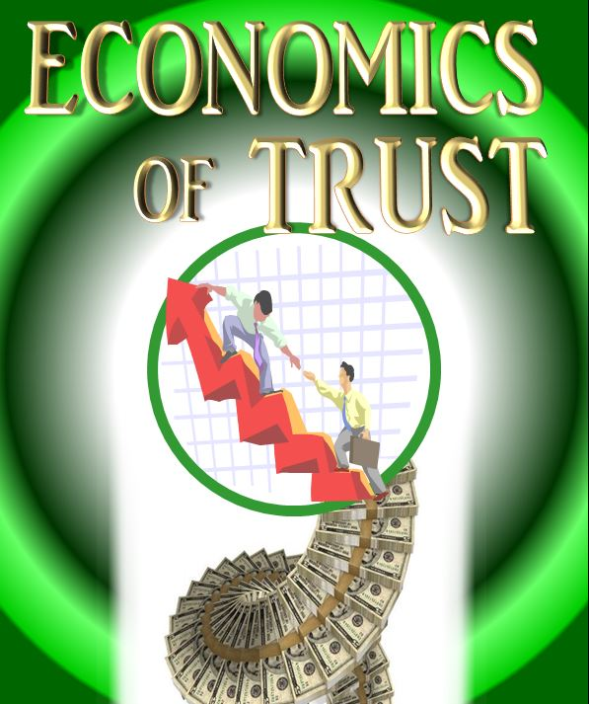

Alliance Management ➔ Collaborative Leadership Shift
Cultural Alignment - Operating System
Part 2- Shape Shifting
Collaborative
Value Creation
Collaboration Produces Significant
Economic Advantage – 25% GAIN*
*based on over 5,000 senior executive inputs
  Increases in Productivity & Profit
  Increases in Speed & Flow
  Increases in Innovation & Problem Solving
  Increases in Simplicity, Synchronicity & Synergy
  Reduction in Non-Value Added Work (Lean)
  Reduction in Breakdowns @ Interfaces
  Reduction in Job Turnover & Disengagement
Economics of Collaboration – endorsed by Senior Economist from World Bank
Trust’s Impact
on Profits
Key Actions: Evaluate Trust’s Impact on Profits (TIP)
Use Alliance Methods to Improve your Company
Key Messages: Alliances are “External Teams” built on Trust
Alliances are the beginning of Collaborative Shift
Notes:
The 5000 inputs from Senior Managers was highly supportive – 25% gains were actually conservative.
See Go Productivity Supply Chain Data
Relate this to Managing Complexity (prior slide)
Collaboration is built on a TRUST Foundation – the Next Slide

Slide 16
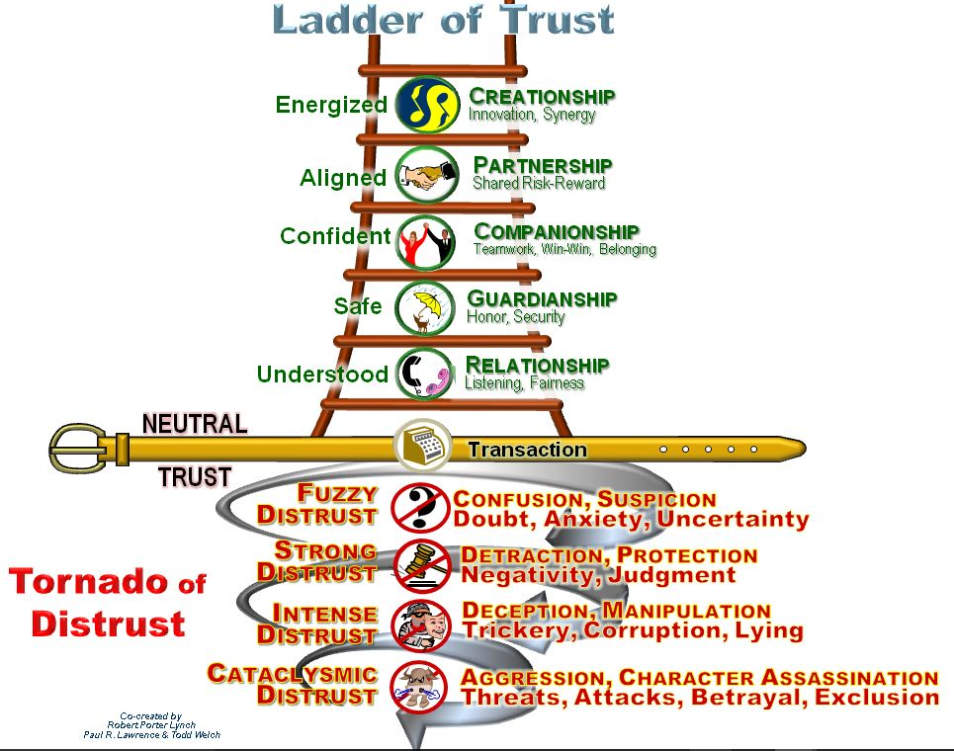
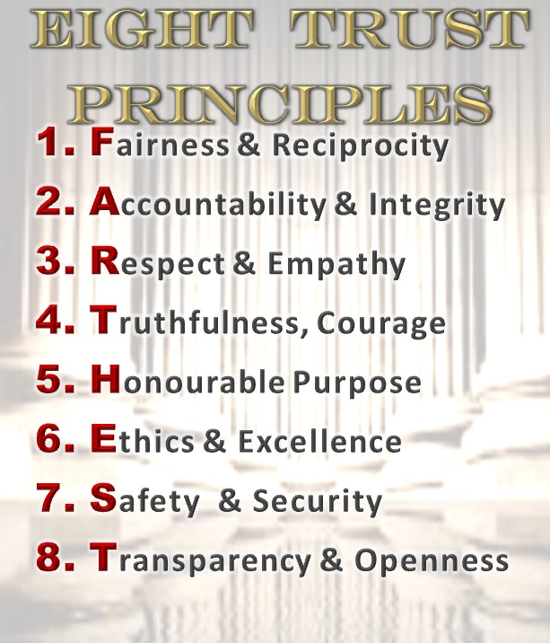

Reliable
Get Results
Integrated
No Silos
No Surprises
Alliance Management ➔ Collaborative Leadership Shift
Cultural Alignment - Teamwork & Trust
Key Actions: Live & Teach Trust, Use Diagnostics
Select Hi-Trust/Performance Teams
Key Messages: Trust is Foundation of Teamwork
Copyright 2017

Slide 17

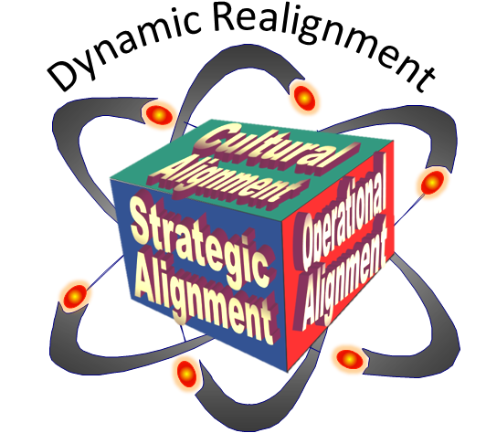

Part 3- Shape Shifting ^{minD MaAps}
Metrics, Architecture, Actions, Pictures, Stories
Alliance Management ➔ Collaborative Leadership Shift
Dynamic ReAlignment
Dynamic ReAlignment:
Innovate/Adapt & Reconfigure/Restructure
as results are achieved & conditions/situations change
  Technology Changes
  Governmental Changes
  Value Evolution is Faster
  Leadership & Personnel Changes
  Acquisitions Shift the Playing Field
  Competitors Enter & Exit
  New Customer Needs
  Adversity Strikes
  Contracts Expire
Dynamic Realignment
Adversity
Crisis
Opportunity
Cultural
Can you Anticipate, Innovate, Adapt?
Alignment
Operational
Strategic
Alignment
Alignment
T i m e
Comp
UNIVERSAL
PASSPORT
ion
it
et
C hange
Key Actions: Use Four Alignments to Create Competitive Advantage
Create Internal Teams & External Alliances/Alignments
Key Messages: Success will Maximize with all Four Alignments
Alliances are Alignments – Use Diagnostics regularly
Notes:
Collaborative Leaders get greater support and coherence when adaptation to change is essential. When Adversarial leaders face change, the organization is suspicious, judgemental, and often will opt out.
SuperBowl LI – Patriots & Falcons – Both teams got there because they were good at all four dimensions.
The Patriots won the game because they were better at Dynamic ReAlignment – Greatest Comeback in Football History
4 Dimensional Alignment is a “Universal Passport” in the sense it can be used for alliances, leadership, teamwork, diagnostics, negotiations, personal development, and on …… ASAP must undergo a Dynamic ReAlignment
Rebuild the Engine while Racing down the Highway

Slide 18


Part 4 - Road to the C-Suite
Alliance Professionals Must Master
New Thinking, Language, & Architecture
GAME CHANGER STRATEGY requires
Become COLLABORATIVE SYSTEMS Orchestrators
Symphony of Synergies -- Not Just Alliance Professionals
THINK, SPEAK & DESIGN Differently – Shift THE Architecture
Advocate, Champion, Demonstrate the Collaborative Imperative
Show LOWER RISK, HIGHER SUCCESS, GREATER PROFIT
through Collaborative Strategies, Culture, Operational Best Practices
Demonstrate VALUE & COMPETITIVE ADVANTAGE
that is MEASURABLE that becomes MONEY
Interact with POWER CENTERS in your Company
Understand Transactional, Deal Mentality - Shift & Elevate Game of Business
EDUCATE, BUILD TRUST & BUILD CAPABILITIES
in the New ARCHITECTURES – people must feel stronger as a result
SIMPLE MAPPS – Metrics, Architecture, Actions, Pictures, Stories
Ask questions that draw people into new understandings

Slide 19

Open Discussion
The Road
to the
C-SuiTe
What’s Important?
What’s Missing?
What Shifts in Thinking?
What’s Possible?
What Actions are Required?
What Must be Done Differently?
Counter-Points?
Key Take-Aways?
RobertLynch@WarrenCo.com

Slide 20
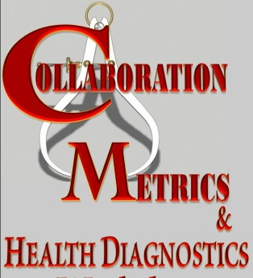
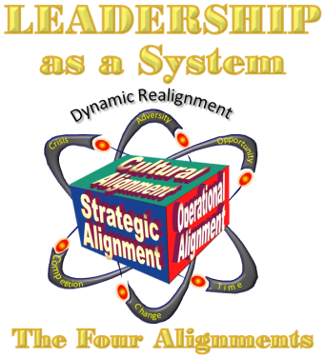
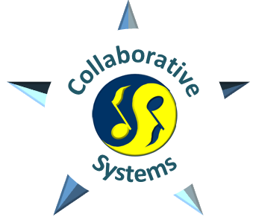
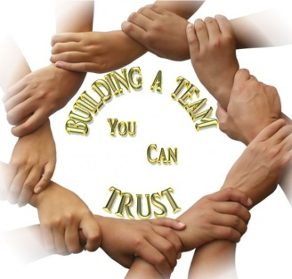
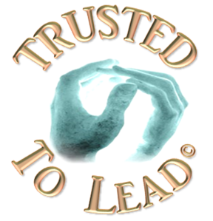

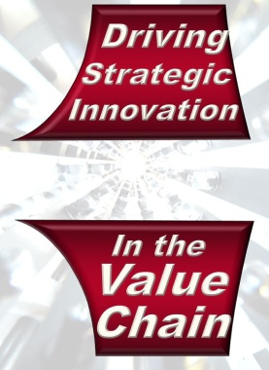
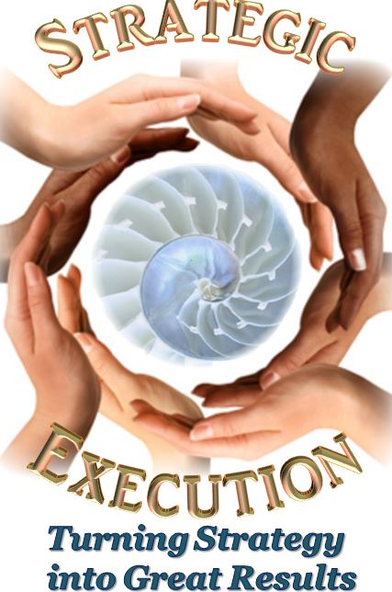
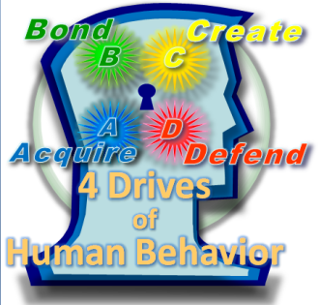

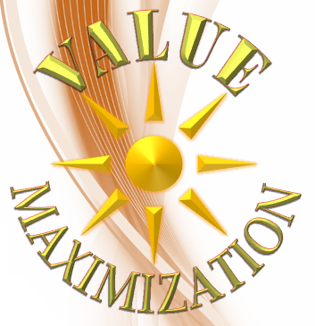
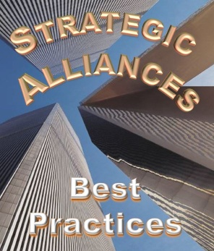

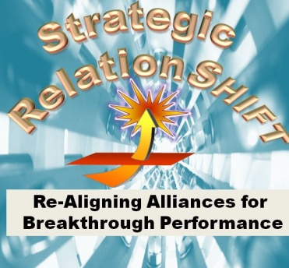



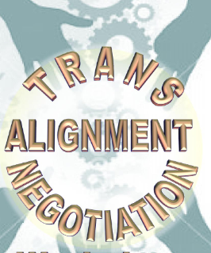
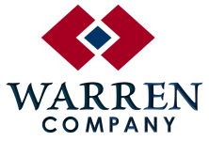
Implementing Game Changing Shifts
Leadership Requires New thinking
Architectures
Programs & Tools
In Partnership with
Come to Naples or We will come to You
RobertLynch@WarrenCo.com
Notes:
Get a toe-hold in reprogramming the muddled minds by ReTraining. Start anywhere people have a curiosity or need. Any one of these programs is a good place to start. Or start with some of the other programs by other contributors to ASAP. If you think you can get into the C-Suite without changing the Muddled Thinking, you are counting on Santa Claus and the Easter Bunny for Deliverance.

Slide 21


Architecture of Teamwork
BUILD A TRUST & TEAMWORK CULTURE WITH PEOPLE
Competence
  Talents
    Knowledge & Experience
    Education, Skills & Abilities
    Analytic Capacity
    Getting Results
Character
  Who You Are
    Wisdom, Judgment,
    Personal Integrity & Accountability
    Values, Honor, Win-Win
    Trustworthiness, Discipline
    Perseverance, Work Ethic
Compassion
  Caring about Others
    Empathy, Sensitivity to another’s concerns
    Willingness to Support Others
    Emotional Maturity
    Ability to anticipate another’s needs
Creativity
  Imagination
    Resourcefulness
    Insight & Curiosity
    Problem Solving Capacity
    Progressive Learning & Thinking
Courage & Commitment
  Championing Spirit
    Clarity of Mission & Purpose
    Commitment & Enthusiasm
    Response Under Pressure
    Ability to live on the edge of uncertainty
    Discipline to Follow-thru to Completion
Collaboration
  How you Interact
    Teamwork, Building Others
    Sharing, The Golden Rule
    Communicating, Listening,
    Giving Credit to Others
21
Notes:
Most managers spend 70% of their time on the weakest members of the team. That’s wrong. Patriots focus their energies on each member’s strength.

Slide 22

Applications of Collaborative Alignment Architecture
LEADERSHIP
MERGERS
NEGOTIATIONS
STRATEGIC ALLIANCES
TURNAROUNDS
DIAGNOSTICS
HUMAN RESOURCES
COMPLEX PROJECT MANAGEMENT
CROSS-FUNCTIONAL INTEGRATON
SUPPLY CHAIN MANAGEMENT
ORGANIZATION TRANSFORMATION
HIGH PERFORMANCE TEAMS
UNIVERSAL
PASSPORT
STRATEGIC EXECUTION
LEAN MANAGEMENT
ACQUISITIONS
COLLABORATIVE INNOVATION
22

Slide 23



Collaborative Alignment Architecture
CERTIFICATE
leadership
COLLABORATIVE
International Collaborative Leadership Institute
23

Slide 24
This is not just a shift in “technique”, it’s a shift to install a “collaborative operating system” in organizations. Just as a computer’s operating system does three things:
  manage the company’s (computer’s) Assets & Resources, such as the human resources, assets, structures, key functional areas, inputs, and outputs, (hardware)
establish a user-interface, (the Culture) especially how people perceive their realities, interact with others, understand their roles, priorities, rewards, punishments, (user) and
execute Functional Operations -- and provide services for applications and functions, such as operations, customer service, delivery of products, research, etc. (software)

