Slide 1

how the
Leadership Institute
can accelerate
Blue Zone’s Impact
International
Collaborative Leadership Institute
Robert Porter Lynch
Robert@ICLInstitute.org

Slide 2

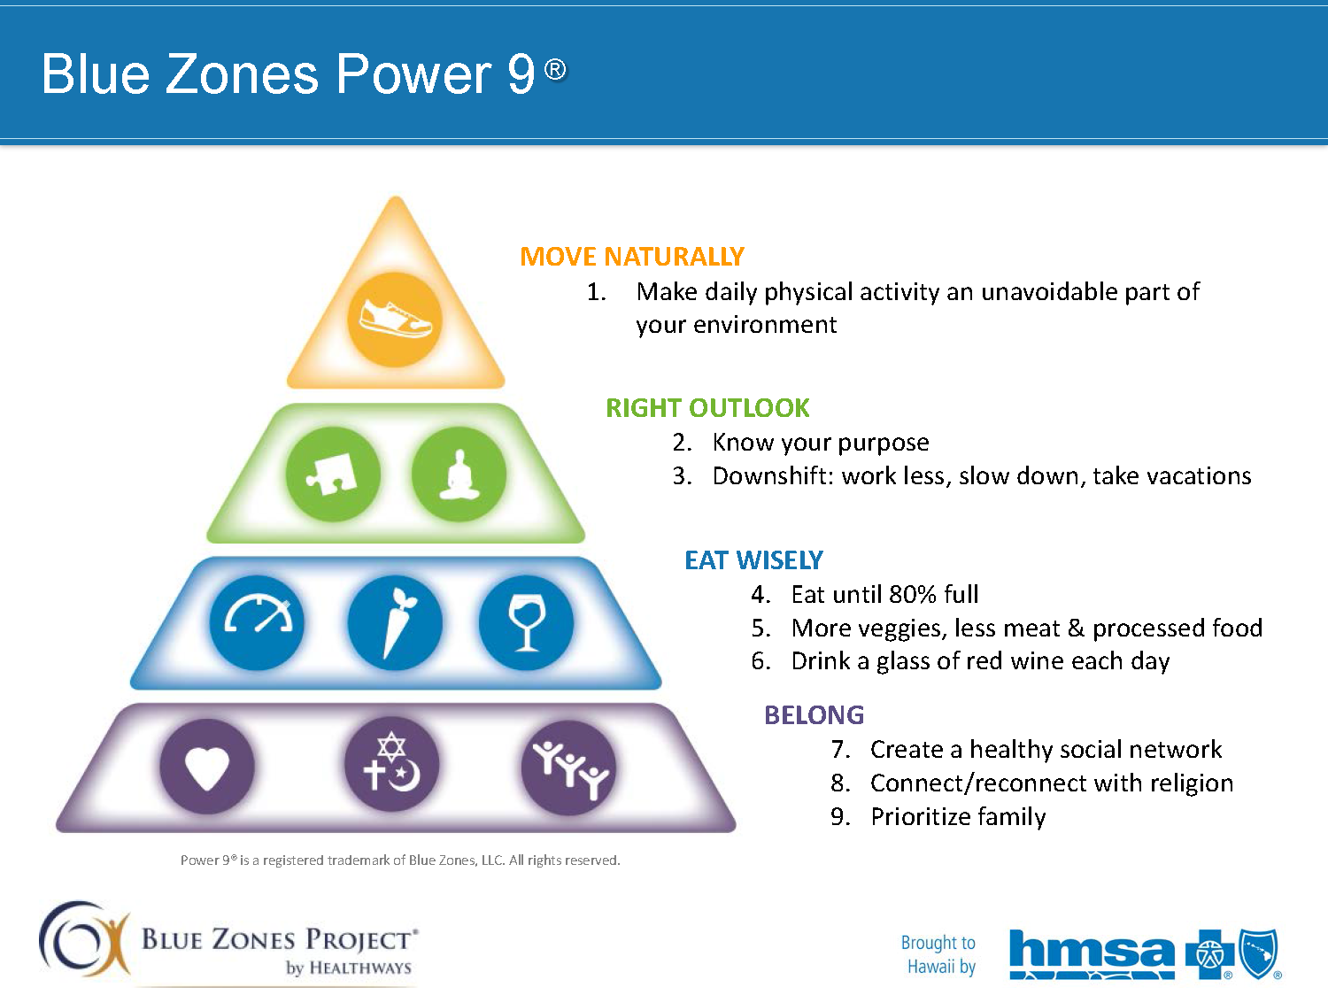
Potential Synergies
Institute’s Strengths
Blue Zone’s Objectives
Mission & Purpose
Response to Adversity
Right Outlook
Know Your Purpose
Reduce Stress
Building Trust
Creating Teams
Belong
Healthy Social Network
Connect with Religion
Prioritize Family *

Slide 3

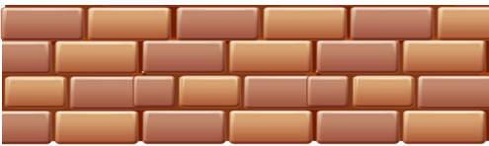
Trust is the Underpinning of All Civilization
ALLIANCES
MILITARY
EDUCATION
GOVERNMENT
ORGANIZATION
CO-CREATION
TEAMWORK
LAW
RELIGION
BUSINESS
COMMUNITY
PEACE
FRIENDSHIP
FAMILY
MARRIAGE
LOVE
TRUST
Foundation of All
Cooperative Enterprise
Fundamental
Concept
Notes:
Can you think of a situation where people have to work together where trust is not a key factor in cooperation.

Slide 4

Where Trust is Most Important
WORK
FAMILY
FRIENDS
COMMUNITY

Slide 5

Impact of Trust on Personal Wellbeing
10% Increase in Trust is:
  Equivalent to a 30-40% increase in pay (in terms of a person’s sense of well being)
    Reduce Employee Turnover by 10-20%
  Will reduce suicides & traffic fatalities by 10%
  Impact on Health Care by stress reduction
  (see next slide)
  - John Helliwell Economics Dept, University of British Columbia based on study of nearly 30,000 Canadians and Americans
What would happen in a community that had Adults & Youth with:
High Levels of Trust?
Meaning & Purpose?
Notes:
Helliwell Study: the wellbeing effects of living in a high-trust environment are even greater. Having high trust in co-workers, which we find to be the largest of all the specific directional trust measures, is associated with 7.6% higher life satisfaction. This is followed trust in neighbours (5%), confidence in police (3%), and a belief that a stranger would return your lost wallet (2.5%) someone who feels a strong sense of belonging to their community is estimated to be 11% more satisfied with his or her life.

Slide 6

High Costs of Healthcare
60% of Disease is Stress Related
Major Causes of Stress:
  Financial Stress
  Relationship Stress
    #1 = Lack of Trust
    (i.e. Major Factor in 100% of all Divorces)
Strategy
  Increase Trust to Reduce Disease
  RESULTING IN LOWER HEALTH CARE COSTS
Fundamental
Concept
Notes:
Lack of Trust
Blame game, Complaining, Criticism, Negativity
Selfishness, No Caring/Respect about others
Manipulation, Deceit
No Means of Resolving Conflict
Fear (unsafe, disrespect, insecure)
Losing Attitude, Low Standards,
Poor Synchronization
Lack of Purpose/Mission
Poor Focus/Goal or Role Clarity
No Accountability/Commitment
Lack of Results & Empowerment
Insufficient Delegation, Recognition or Reward
No one cares, I don’t make a difference
Lack of Learning/Innovation/Creativity
Breakdowns in Face of Adversity
Lack of Competency/Skills/Experience
Lack of Collaborative Leadership

Slide 7
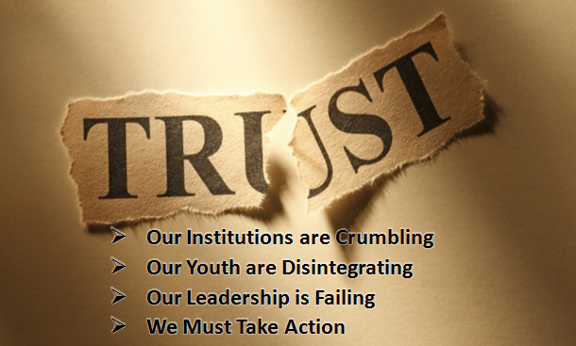

DisTrust in America
Senior Executives rate Trust either a 9 or 10 (10 being the highest)
in terms of it’s importance in any business or personal relationship.
1/2 min
Notes:
On 3X5 Cards #Rating &WHY?
Institutions are how culture (learnings, values, priorities, etc.) is transmitted from one generation to another.
However, very, very, few have ever taken a Course in Trust.
When asked: “If you wrote down all you knew about Trust,
how much would you write?” the typical Senior Executive states: “About ½ page.”
How can this be so? ….. For something so important, it’s not taught at any level of school – high school or college.

Slide 8
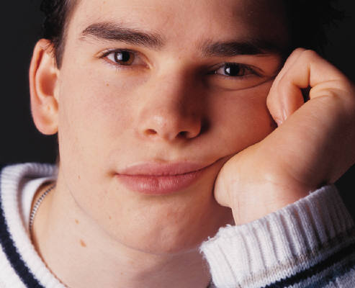
DisTrust in America
Sentinel Species -- Youth in Peril
When Institutions Fail ………
Values Disintegrate & Civilizations Decline
Problem is Pandemic
Death – Suicide Skyrocketing
Second leading cause of death
- One teenage Suicide Attempt every 20 seconds
Depression – No Hope leads to drugs
Drugs – 20% Potential Addiction
Dropouts – 30% No Future
Destruction – Violence & Gangs
  - Chicago: one shooting victim every 2 hours
Despair – 50% “American Dream is Dead”
2 min
Notes:
In the time it took to discuss this slide, 6 or more teenagers tried to commit suicide in America
Millenials in the Work Force
Will comprise 50% of work force
in 10 years
All ready have one foot out the door
25% plan to leave their jobs within a year
2/3rd plan to leave within 4 years
What they want from work (partial list):
Opportunities to be leaders
Sense of meaning from my work
Professional development training programs
Positive impact on society
Strong sense of purpose
A leading company that people admire

Slide 9

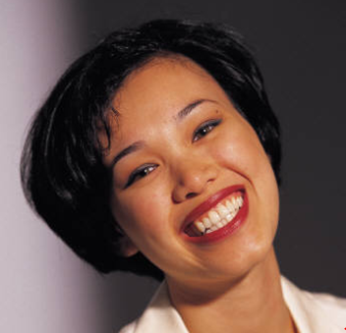


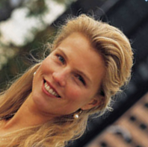
Youth Leadership
MISSION
ADVERSITY
Program
LEADING
TRUST
2 min
Time: 40 min

Slide 10


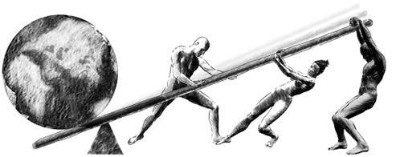
Rebuilding Trust in America
60 – 70 % of All Human Behavior is Culturally Determined
Leadership is the #1 Influencer of Culture
COLLABORATIVE
LEADERSHIP
ICLI
CHARACTER
TRUST
TEAMWORK
We are Strategic – Focused on Root Causes
1 ½ min
Notes:
Why is the Military the Most Trusted Institution in America?)
LEADERSHIP generates CULTURE that produces RESULTS
Leaders create Vision
Leaders frame Perceptions
Leaders set Priorities
Leaders create the Trust
Leaders build the Teams
Leaders choose & organize the People
Leaders reward the Ethics & Values

