Slide 1

Building Trusted Leaders
ICLI
International Collaborative
Leadership Institute

Slide 2
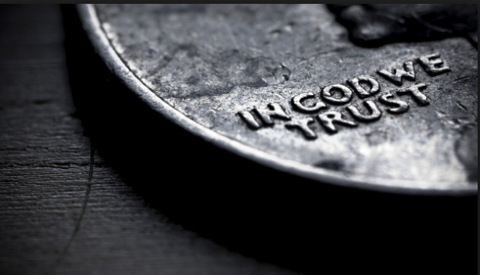
The
State of DisTrust in America
1/2 min
Notes:
Introduction – TRUST: It’s Current Condition, The Consequences, What Can Be Done, The Leadership Institute == why we need better leaders
Put yourself in the Role of a Senior Executive – 3 to 4 other members of your Executive Team at the table.
Interactive
Why a Leadership Institute – College: Leave the World a better place than you found it.
Quick Journey – Leadership – 4H, Boy Scouts, ROTC, Historian, Background in Int. Rel. & Org. Behavior, Military, Service to Community, Consultant to Fortune 500 and teaches in 3 Universities. Author of several books and numerous articles on leadership, alliances, innovation, and trust – with more to follow.
Breakthroughs in Leadership --

Slide 3
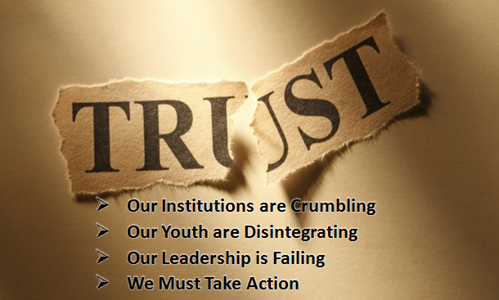
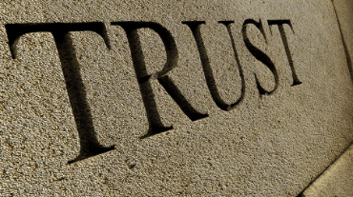
DisTrust in America
Senior Executives rate Trust either a 9 or 10 (10 being the highest)
in terms of it’s importance in any business or personal relationship.
1/2 min
Notes:
On 3X5 Cards #Rating &WHY?
Institutions are how culture (learnings, values, priorities, etc.) is transmitted from one generation to another.
However, very, very, few have ever taken a Course in Trust.
When asked: “If you wrote down all you knew about Trust,
how much would you write?” the typical Senior Executive states: “About ½ page.”
How can this be so? ….. For something so important, it’s not taught at any level of school – high school or college.

Slide 4
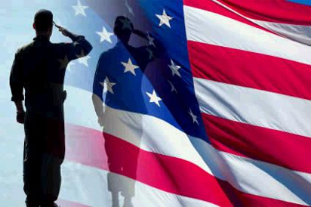

Trust in America
The Most Trusted Institutions
Here’s the Good News:
Military
72%
“% Trust all” or “Most of the time”
But it doesn’t get better...
Small Business
67%
Source: Gallup Poll Dec 2015
1 min

Slide 5
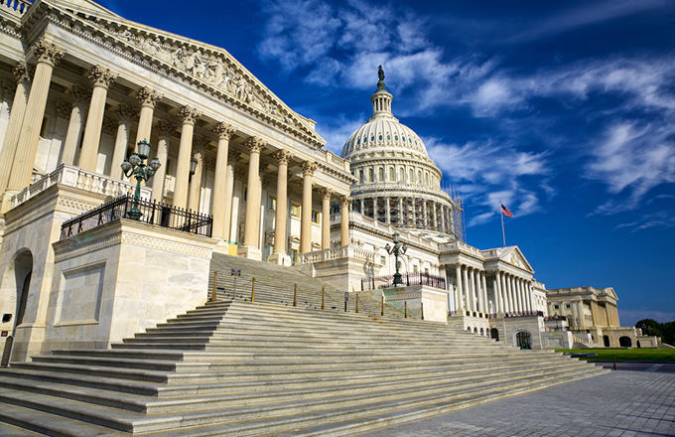
DisTrust in America
Presidency
Supreme Court
Government
Congress
33%
32%
19%
8%
Used Car Dealers
8%
United Nations
38%
Source: Gallup Poll Dec 2015
2 min

Slide 6
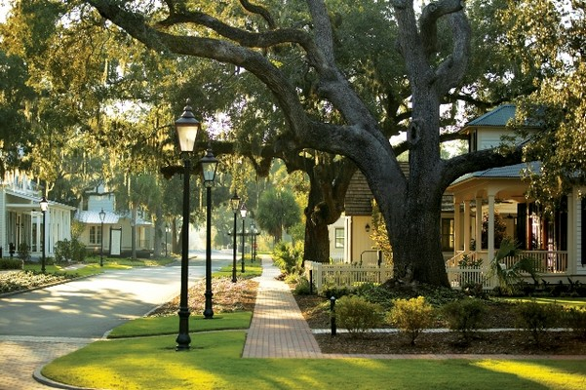
DisTrust in America
How do Local Communities Fare?
Police
Church/Organized Religion *
Public Schools
52%
42%
31%
Medical System
37%
Newspapers
Television News
24%
21%
Big Business
21%
* Organized Religion was the most trusted institution in America during the 1970s & ‘80s with 66% trust ratings
Source: Gallup Poll Dec 2015
2 min

Slide 7
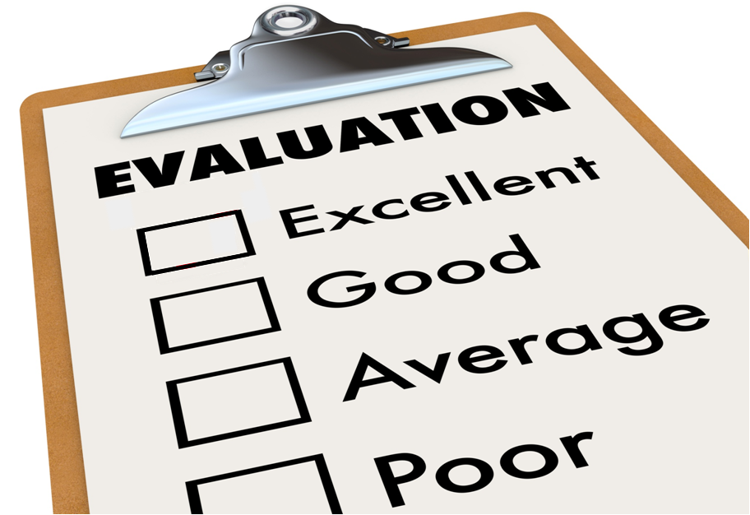
Why is Trust in American Institutions so important?
Institutions Transfer:
the Values, Standards of Excellence, and
Knowledge of American Culture
from one generation to the next.
✓
1 min
Notes:
Institutions transfer civilization’s knowledge, understanding, values, traditions, beliefs.
Does it have to be this way?
What can we do to change it?

Slide 8

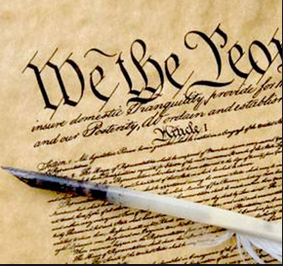
If you were a
Given these indicators…..
What would you predict for the future?
  Smooth Sailing?
  Rough Waters?
  Crew Mutiny?
  Leaks Below the Waterline?
  Structural Damage?

Slide 9
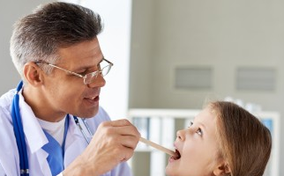
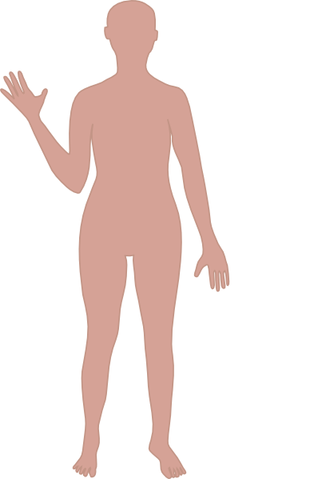
If you were a
Doctor
?
And if National Institutions were
Organs in the
Human Body,
given the trust
levels and the trends,
what would be your:
  Diagnosis?
  Prognosis for Survival?
Government
Police
Education
Religion
Business
Banking
Military
Media
Notes:
Multiple Organ Systems Dysfunction
Only 15% chance of survival

Slide 10
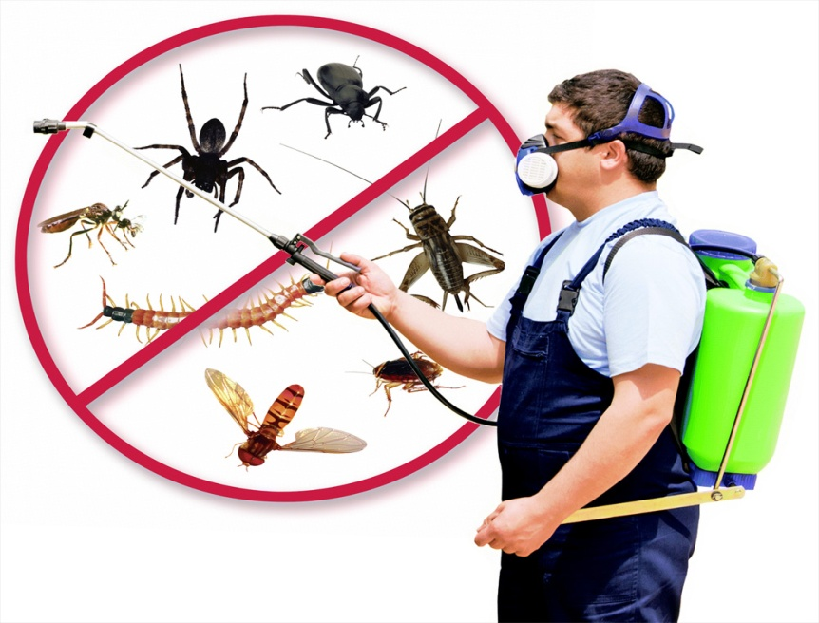
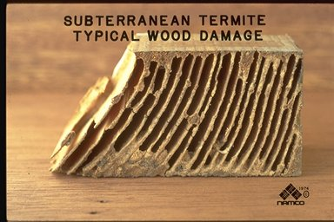
If you were an expert in Pest Control
What would
Distrust in Institutions resemble?

Slide 11
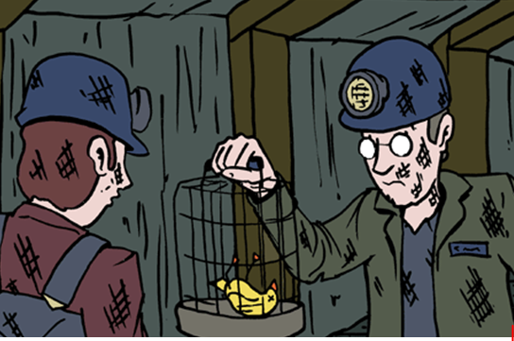
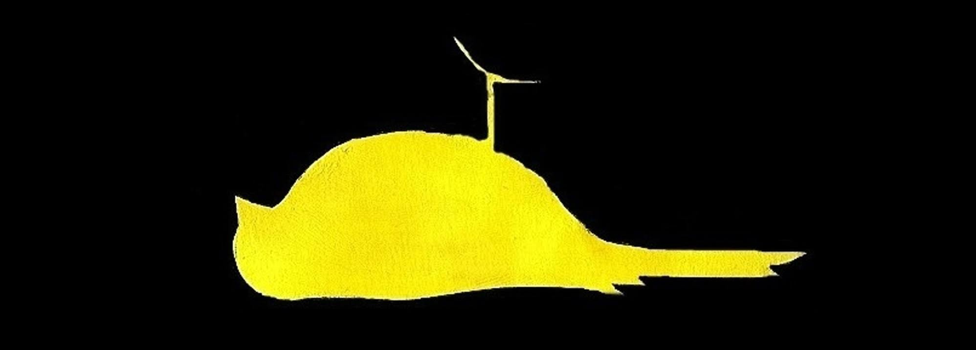
“Sentinel Species”
Provide Warning Signs of Toxicity
Canary in the Coal Mine

Slide 12
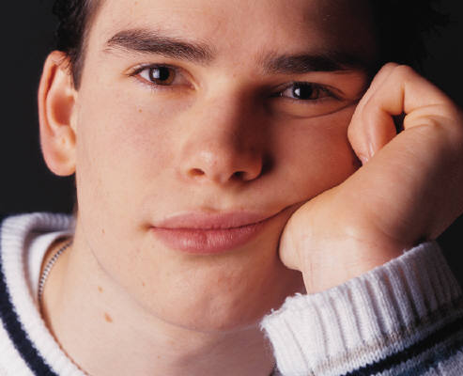
DisTrust in America
Sentinel Species -- Youth in Peril
When Institutions Fail ………
Values Disintegrate & Civilizations Decline
Problem is Pandemic
Death – Suicide Skyrocketing
Second leading cause of death
- One teenage Suicide Attempt every 20 seconds
Depression – No Hope leads to drugs
Drugs – 20% Potential Addiction
Dropouts – 30% No Future
Destruction – Violence & Gangs
  - Chicago: one shooting victim every 2 hours
Despair – 50% “American Dream is Dead”
2 min
Notes:
In the time it took to discuss this slide, 6 or more teenagers tried to commit suicide in America
Millenials in the Work Force
Will comprise 50% of work force
in 10 years
All ready have one foot out the door
25% plan to leave their jobs within a year
2/3rd plan to leave within 4 years
What they want from work (partial list):
Opportunities to be leaders
Sense of meaning from my work
Professional development training programs
Positive impact on society
Strong sense of purpose
A leading company that people admire

Slide 13



DisTrust in America
Our Institutions are Crumbling
Our Youth are Disintegrating
Only Leaders Build Trust in Institutions
Leadership
is FAILING
1/2 min
Notes:
When people don’t trust their institutions, it means they don’t trust the Leaders of the Institutions.
I had a vision of a very different world when I reached Retirement Age. Some of us won’t stand by and let this happen on our watch. Leadership is what determines Institutional Trust & Culture.
L

Slide 14

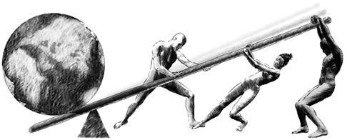
Rebuilding Trust in America
What we can do to change the course of destiny?
COLLABORATIVE
LEADERSHIP
ICLI
CHARACTER
TRUST
TEAMWORK
We are Strategic – Focused on Root Causes
1 ½ min
Notes:
Why is the Military the Most Trusted Institution in America?)
LEADERSHIP generates CULTURE that produces RESULTS
Leaders create Vision
Leaders frame Perceptions
Leaders set Priorities
Leaders create the Trust
Leaders build the Teams
Leaders choose & organize the People
Leaders reward the Ethics & Values

Slide 15
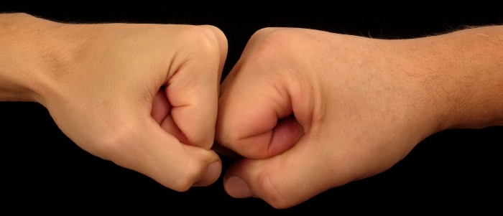

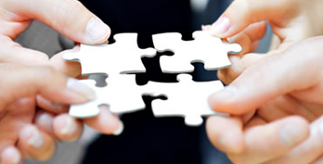
Three Basic Forms of Leadership
Adversarial
Transactional
Collaborative
Gain Advantage
Manipulation
Win-Lose
Survival of Fittest
Might makes Right
“Deal”
Quid Pro Quo
Trade
Buy Low - Sell High
Self Interest
Teamwork & Trust
Synergy
Work Ethic
Value Differences
Mutual Benefit
MUDDLED

Slide 16
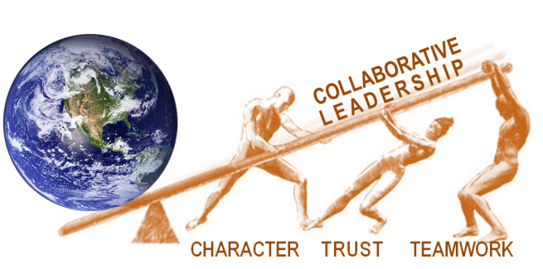
Why
Collaborative Leadership is Essential
Leadership stands at the pinnacle of all
factors in determining success or failure
  in personal life, in family, in community,
  and in organizations.
People don’t work for companies,
they work for their leaders.
  Across America leaders are failing
    Evidence: extraordinary levels of distrust and job turn­over, particularly among Millennials, (dominant in the workforce)
For Youth:
Life is not just lived,
……………..one must learn to lead one’s life
LEADERSHIP
is STRATEGIC
LEVERAGE
1 ½ min

Slide 17
Our Mission
Introduce the Most Effective Forms of
Trust-Based Collaborative Leadership to:
  Future leaders (in high school and college)
  Current leaders (in existing organizations)
Build an Organizational Structure for Collaborative Leadership:
  Youth Leadership Program, and
  Executive & Manager Development Program
  delivering Trusted to Lead sessions by Thought Leaders
  (which creates positive cash flow) then….
  College of Management in Collaborative Leadership
ICLI
1 ½ min

Slide 18
Institute’s Structure
Core Curriculum
Collaborative Innovation
Trust Based Leadership
Youth
Executive
Global Leadership Roundtables
Collaborative
Research
ICLI
International Collaborative
Leadership Institute
3510 Kraft Road
Naples, Florida 34105
International Leadership Network
Leadership
Alliances
Global
Thought
Leadership
1 ½ min

Slide 19
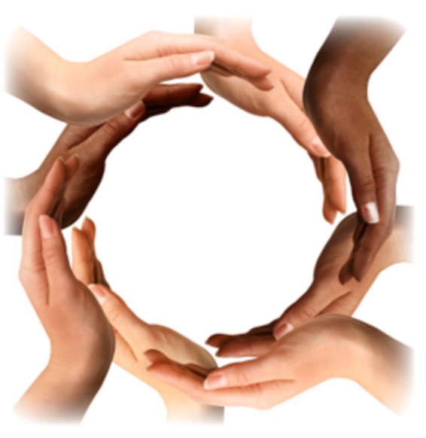
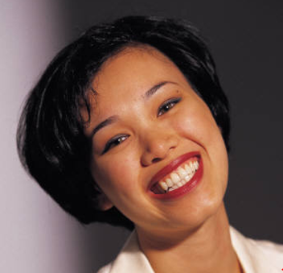
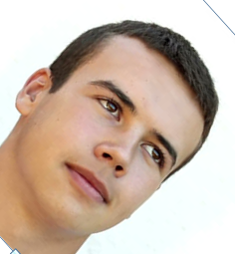
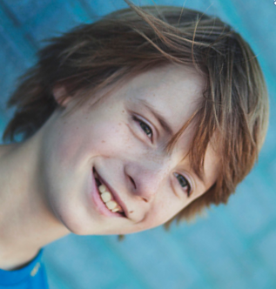
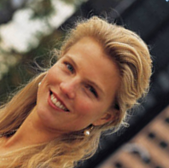
Youth Leadership
MISSION
ADVERSITY
Program
LEADING
TRUST
2 min
Time: 40 min

Slide 20
Youth Leadership Initiative
“MALT” Action-Research Pilot Program
  Building Regional Stakeholder Alliance
    Leadership Institute is joining forces with the Educational, Business, and Workforce Community
  Create a Model Youth Leadership Program
  Build Trust-Based Collaborative Leadership Skills & Capabilities
    Target Audience In 15-21 year old students
  Engage 3-5 Pilot Projects
    South West Florida -- 90-160 Students
    Each Pilot has its own Unique Characteristics
    Engage Teachers and Parents
    Share Learnings & Best Practices Quarterly
    Best-Practice Focused, Data-Driven monitoring/evaluation
  Establish Key Metrics & Performance Criteria
    5yr Long-Term Evaluation Study
  Expand into Florida then Nationally
MISSION
M
A
L
ADVERSITY
LEADING
T
TRUST
This Program is in the
Developmental Stages
please give us your
ideas & insights

Slide 21
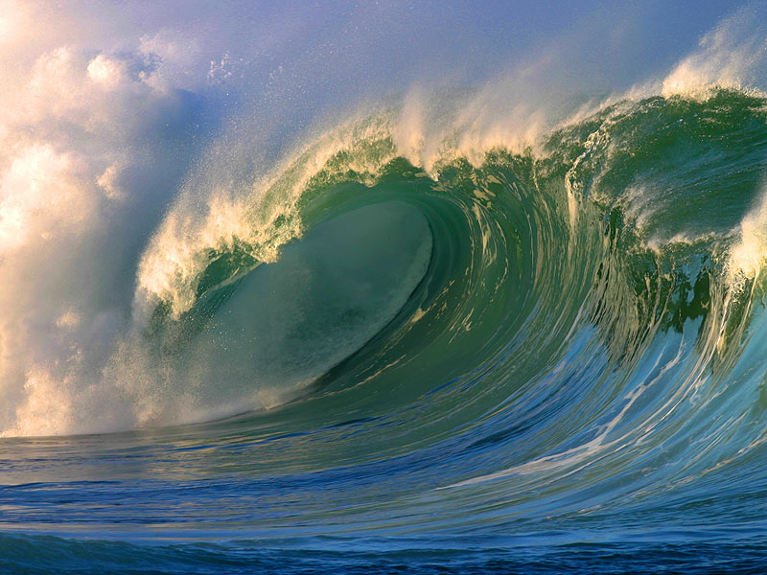
Turning the Tide
We expect the MALT program will have a significant and demonstrable impact
Diminish Negative Indicators
Increase Positive Indicators
“Big Ds”
Drug usage
Depression
Death by suicide
Dropout rates
Discrimination
(such as bullying)
Destruction
(violence & gangs)
Character-based Behaviors
& Social Values
Civic Contribution & Engagement,
Academic Achievement
Healthy Living
Caring for Others
Better Work Ethic
Better Personal/Parenting Skills
& Relationships
Trustworthiness
Higher Resiliency in Crisis
Positive Attitude on Life

Slide 22
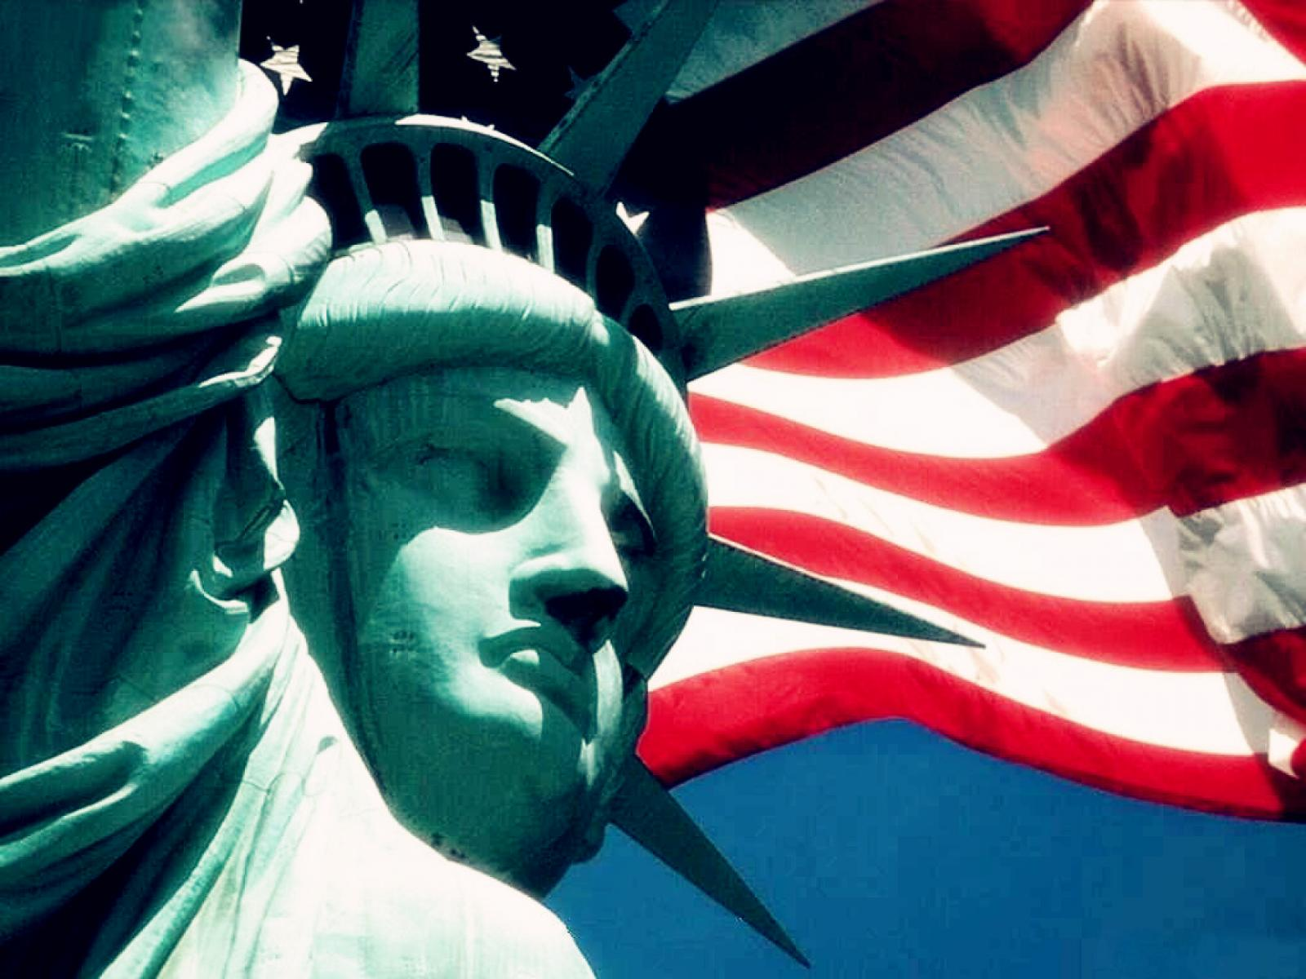

Rebuilding
TRUST
IN
America
Leaving Our Nation
Better than we Found it!

Slide 23
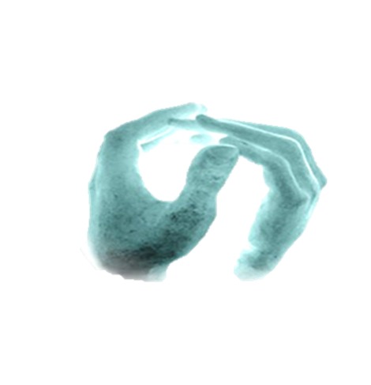
TRUSTED
to
LEAD ©
Thank You!
Happy New Year
Committed to Rebuild Trust in America
Learn more about our strategies and programs at www.ICLInstitute.com

Slide 24

To Build or Rebuild Trust,
Objective: take trust out of the "fuzzy & soft" feel-good field
into something more "firm & smart" that's actionable.
You Must First Understand
the
NATURE of
HUMAN
NATURE

Slide 25
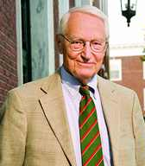
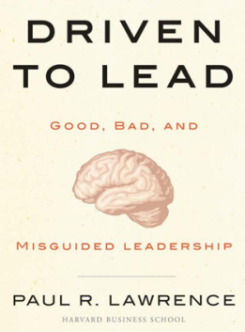
Four Drives
of Human Behavior
Leadership
& Culture
Drive to
B
Bond
Drive to
C
Create
Fundamental
Concept
Drives are
Independent
but Interactive
Each must be
reasonably satisfied
for a human being
to be effective & happy
● Invent
Leadership determines
how each of the four
drives are predominant
or
subordinate
in the Culture
Collaborate ●
Love ● Care
● Inquire
Engage ●
● Learn
Accountable Goals ●
● Safety
Control ●
Horde ● Greed
● Protect
● Fear
Dominate ●
● Attack
Drive to
A
Acquire
Drive to
D
Defend
C
B
B
C
= Vision & Vitality Based
= Empire Building
= Tribal Isolation (Silos)
A
D
A
D
= Greed & Fear (Self-interest)
Notes:
Lawrence is a preeminent authority on Organizational Behavior. He spent 20 years researching Anthropology, Archeology, Economics, Evolutionary Biology, NeuroScience, Psychology, Political Science, Sociology, Social Psychology to develop a Comprehensive Theory of Human Behavior.
Drives are Semi-Autonomous, Different Degrees and Contexts for each person
If the “upper” drives go dormant – no teamwork (silos & Machiavelli) and no innovation (except creative subversion – NUMMI example)

Slide 26
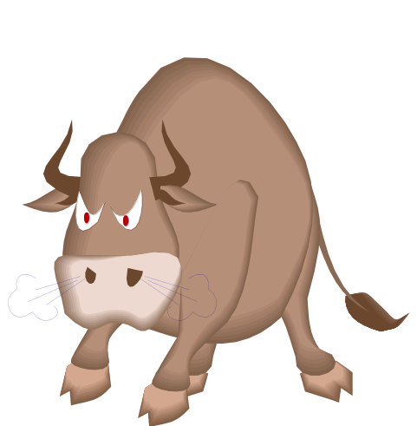
human beings aren’t wired to trust what we fear
To Understand TRUST,
MUST First UNDERSTAND DISTRUST
Fear is a form of Brainwashing!
Focus on Self-Interest (Fright)
Withdraw (Flight)
Withhold (Sleight)
Attack (Fight)
Primal Emotion-- Unless Checked,
will Override All Rational Action
26
Notes:
Fear is known as a “primal emotion” – often becomes revenge and uncontrolled anger
Brain Chemistry underpins the Brainwashing Phenomenon – Adrenaline shuts of Oxytocin

Slide 27
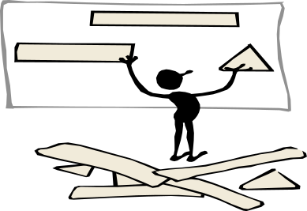
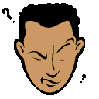
What causes “FUZZY” Distrust?
Undefined FEELING of ANXIETY or STRESS
Ill-at-Ease ANTICIPATION of FEAR or HARM ….
  Uncertainty & Ambiguity
  Paradoxical Complexity
  Continual Reorganization
  Continuous Change
  Conflicting Goals
  Unclear Direction
  Fuzzy Mission Statements
  Mixed Messages
  Misaligned Rewards
  Mixed Leadership Styles
  Political Cross-fire
  Insufficient Collaboration
  Silo Mentality
  Chaos & Turbulence
  Anxiety & Stress
Fuzzy Fear:
The Brain is a Pattern Recognition
Machine: Fuzzy Fear has no pattern or an incomplete or unaligned pattern
The Brain makes Assumptions to complete the Recognition of a Pattern, but the chance of accuracy is based only on Experience
If Experience or Culture has been negative, the Assumption is Negative
Seek Protection behind Castle Walls
Fuzzy Fear is DEGENERATIVE – Often Triggering Deeper, More Intense Fear & Resistance to Change
27
Notes:
People have very different Tolerances for Ambiguity and Uncertainty
Typical Legal Response – Contracts and “Deal Structure”

Slide 28
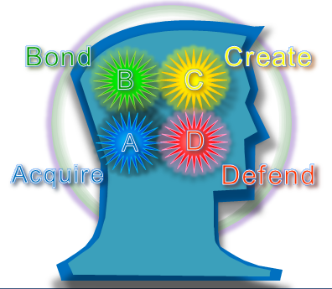
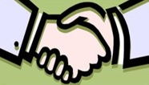
Primary Chemistry of the Four Drives
Brain Chemistry is Important because it
Responds Instantly to ALL Sensory INPUTS
dAcquire
➔Dopamine
dBond
➔Oxytocin
dCreate
➔ Opioids
dDefend
➔ Adrenaline
Targets an Objective
Goal Oriented
Feels Pleasure in
Achievement or Anticipation of Acquiring the Target
TOO MUCH
  Makes one Obsessive Compulsive
  Triggers dDefend in others (Win-Lose)
Enables all Collaboration
  Trust
  Love
  Empathy
  Teamwork
  Relationships
Humans without it LACK Conscience
Cannot have too much of it
Generates Endorphins
  Creativity
  Immunity
  Lightness
Exploration, Inquiry, Discovery, Dreaming
Cannot have too much of it (Artificial Opioids [drugs] produce illusory results)
Response to Needs for Safety
Controls Excitement
Too Much:
- Causes Distress
- Triggers Fear
Response
  Fight
  Flight
  Freeze
  - Large Amounts are Antagonistic to Opioids, Dopamine, Oxytocin
Source: Research Synopsis by Robert Porter Lynch & Paul R. Lawrence, May-June 2011
Notes:
These are the Four Primary Neurotransmitters. There are hundreds of others – secondary & tertiary -- like Serotonin, Testosterone, Cortisol, etc. etc. As a leader its not critical to know about or micromanage all these others because the brain has had millions of years to evolve to manage the interactive details.

Slide 29
Brain Chemistry Controls Trust
Zone of High Trust & Performance
drive: DEFEND
adrenaline
Four Key Hormones affecting Brain Response are
Four Key Hormones affecting Brain Response are Antagonistic
High
⬅ Harmonious ---------- Synergistic -----------Antagonistic ➔
Brain Hormone
(Neuro-transmitter) Production
Moderate
drive: ACQUIRE
dopamine
drive: CREATE
opioids
drive: BOND
Oxytocin - Women
drive: BOND
Oxytocin – Men
Low
Anxiety/Stress Level
Leadership Options
Triggering
Hormonal
Responses in Brain
Low
Energy
Positive
Stress
Chronic
Stress
Debilitating
Stress
Low Stress
Safety, Calm
Boredom,
Calm, Restful
Complacency
Minor Stress
Hopefulness
Interest
Confidence
Curiosity
Moderate Stress
Discomfort
Inquisitiveness
Exploration
Fascination
Enthusiasm
Major Stress
Anxiety/Worry
Frustration/Upset
Apprehension
Hurt/Guilt
Extreme Stress
Danger/Fear
Terror/Dread
Turmoil/Hyper-Anxiety
Anger/Rage/Panic
Leader’s Role is to Modulate Stress Levels to Produce Max Performance
& Max Trust
Fuzzy Distrust
Fearful Distrust
Notes:
Note: for the sake of simplicity, we are using the terms “Hormone” and “Neurotransmitters” interchangeably. Technically they are different, but for practical purposes, the layman can just talk about hormones
Adrenaline: A cup of Coffee in the morning gives you a “kick” to move from low energy to positive stress
Too many cups of coffee gives you a buzz which is too much adrenaline, and you start to lose focus
Men know when a woman gets Angry you can’t hug her – because her Oxytocin levels have fallen into oblivion, but the man’s Oxytocin is still at about 50%. But she probably will bitch and complain a lot, but probably won’t attack. While he can love and be angry at the same time, while she can’t because her Oxytocin has Grounded Out. But if the man goes into Rage, his Oxytocin levels will also have grounded out, and he could become dangerously aggressive.
A Hug, deep listening, or safe words will help trigger Oxytocin production
Too much stress will cause Adrenal burnout, and diminish endorphin production, causing deterioration of the immune system, resulting in deterioration of health.

Slide 30

Ladder of Trust
Energized
Creationship
Innovation, Synergy
Aligned
Partnership
Shared Risk-Reward
Confident
Companionship
Teamwork, Win-Win, Belonging
Drive to
Bond
“Teamwork”
Drive to
Create
“Innovation”
Safe
Guardianship
Honor, Security
● Invent
Understood
Relationship
Listening, Fairness
NEUTRAL
TRUST
Collaborate ●
Love ● Care
● Inquire
Engage ●
Transaction
● Learn
Drive to Acquire
“Self Interest”
Fuzzy
Distrust
Drive to
Defend
“Fear”
Confusion, Suspicion
Doubt, Anxiety, Uncertainty
● Safety
Strong
Distrust
Goals ●
Detraction, Protection
Negativity, Judgment
Control ●
Horde ● Greed
● Protect
● Fear
Dominate ●
● Attack
Intense
Distrust
Deception, Manipulation
Trickery, Corruption, Lying
Cataclysmic
Distrust
Aggression, Character Assassination
Threats, Attacks, Betrayal, Exclusion
Fundamental
Concept
Co-created by
Robert Porter Lynch
Paul R. Lawrence & Todd Welch
Tornado of Distrust
30

Slide 31
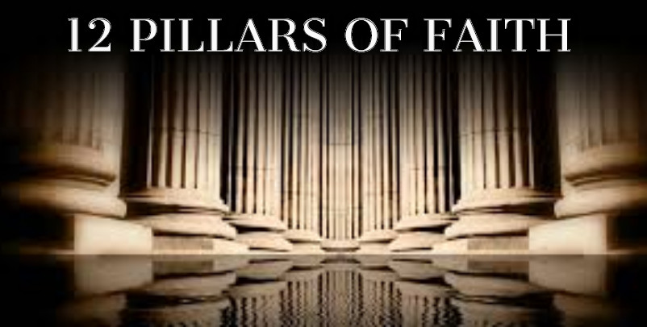
EIGHT TRUST PRINCIPLES
Fairness & Reciprocity
Accountability & Integrity
Respect & Empathy
Truthfulness, Courage
Honourable Purpose
Ethics & Excellence
Safety & Security
Transparency & Openness
Best
Practice
2 min
Notes:
These are NOT listed in Priority Order
Do only the First Four, and what do you get???
Notes:
Aligned Commitment means a Unified Conviction about how to mold the future

Slide 32
Leadership as a System
➔4 Dimensional Collaborative Alignment
◆ Strategic Alignment:
Co-Create an Inspirational Common Vision,
then chart an Innovative Strategic Course
that generates a Significant Advantage
or Improvement over the Competition.
◆ Cultural/Leadership Alignment:
Leaders build a Culture of Trust & Teamwork
& Governance that Unleashes & Focuses
Human Energy on Achieving the Strategy.
◆ Operational Alignment:
Build Coherent Organizational Teams,
with Accountability, Measures of Success,
Best Practices & Rewards that produce great results.
◆ Dynamic ReAlignment:
Innovate/Adapt & Reconfigure/Restructure as results are achieved and conditions/situations change
Dynamic Realignment
Adversity
Crisis
Opportunity
Cultural &
Leadership
Alignment
Operational
Strategic
Alignment
Alignment
T i m e
Comp
ion
it
et
C hange

