Slide 1

Note: View in Presentation Mode
TRUSTED
to Lead ©
SERIES
Core Architectures of the Leadership System

Slide 2
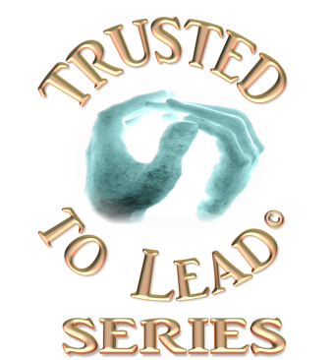

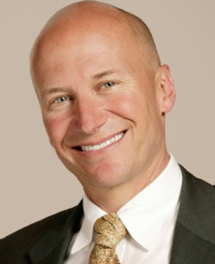
Testimonials
Just a Few Sample Commentaries………Fresh New Thinking and Inspired Action
Robert Porter Lynch’s work combines
depth of insight, clarity of thought, understanding of complexity, mastery
of expression, and passionate intensity for the vitality of leadership.
– Paul R. Lawrence,
Professor Emeritus,
Harvard Business School
Robert Porter Lynch has the missing code on trust....His new approach to trust is exceptional. There's an important difference between
subject matter experts and real
groundbreaking thinkers;
he's definitely the latter.
-- Paul G. Stoltz,
Author: Adversity Advantage
➔See More Testimonials or click to go to Next Slide

Slide 3
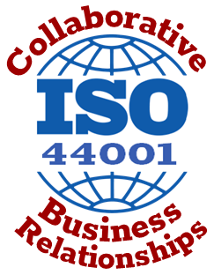
The Time is Now
Leadership Problems Evident Everywhere
The Opportunity is NOW
Trust in our Cherished Institutions at Perilously Low Level.
  No Recovery in Sight.
Productivity in business has flat-lined.
Millennials – are restless and disengaged.
  Soon will make up 50% of the workforce
  25% leave their jobs every year.
  Replacement cost: $15K-$25K per employee
The Leadership Crisis in Washington
has hit a crescendo – people are paying attention to leadership in a very big way.
The International Standards Institute (ISO) just issued guidelines for Collaborative Business Relationships that fit our Collaborative Excellence frame-works like a glove.

Slide 4
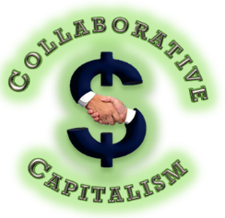
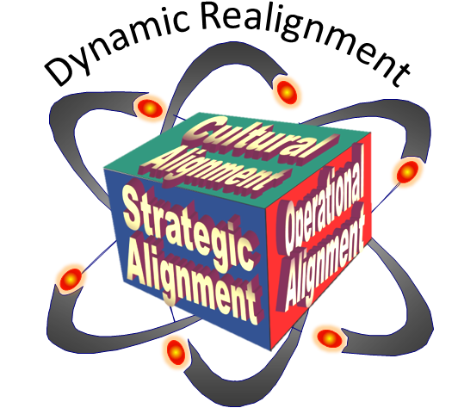
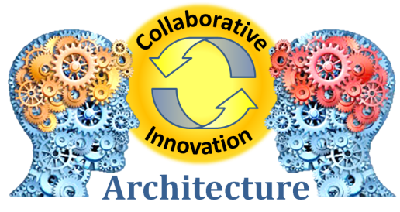

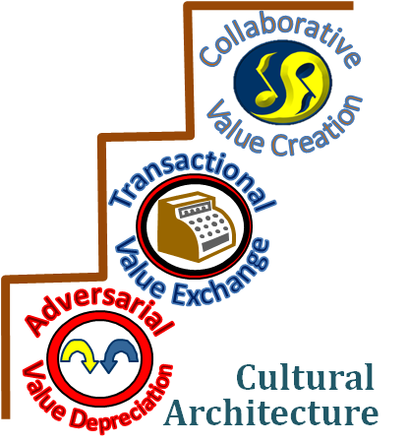
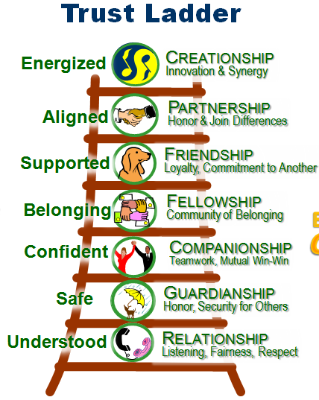


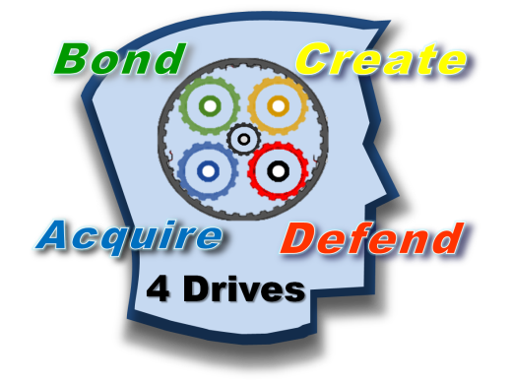

Core Collaborative Architectures
30 years in the making to discover, design, develop & test the first fully integrated system that
connects
6 levels to
produce
25%
competitive
advantage
Leadership
Economics
4 –Dimensional
Leadership Architecture
Architecture
innovation
These six architectures
are simple, easy to learn, elegant to use, and produce measurable results with minimal resources.
All six are woven into the fabric of each book in the Trusted to Lead TM series.
culture
Trust
Human drives
ARCHITECTUREs
Trust Architecture
Human Behavior Architecture
Value Delivered ➔ Leadership as a “Integrated System” produces Quantum Jumps in Performance

Slide 5
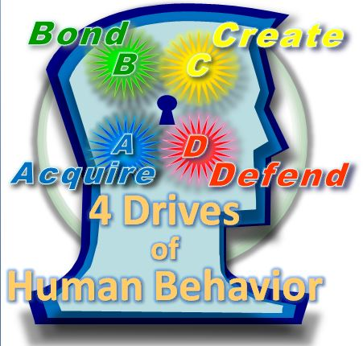
4-Drive Human Behavior Architecture
Human drives
Leaders as “Architects” design their organization’s future
ARCHITECTURE
Foundational Architecture
Developed by mentor and colleague Paul Lawrence (now deceased) of Harvard Business School.
Elegantly simple & straightforward
Four Drives of the Brain explains, predicts and prescribes behavior.
Model is far better than Maslow’s Hierarchy.
Backed up by breakthrough neuro-chemistry research conducted with Prof. Lawrence.
Flows directly in Trust & Culture Architectures
Explains why people are “driven” to act
Value Delivered ➔ Quickly Understand Dysfunctions | ReAlign & ReBalance Individuals & Teams

Slide 6
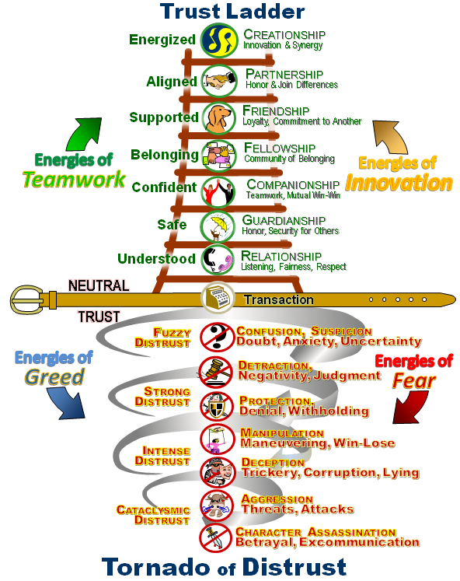
Trust Architecture
Trust
Human drives
➔ 4-Drive Architecture makes a fluid transition into the Trust Architecture
ARCHITECTURE
Elegantly Simple to Understand & Use
Trust Ladder & Tornado of Distrust -- powerful tool to create extraordinary relationships.
Based on Breakthroughs in Neuro-Chemistry
Without trust:
  Impossible to generate a high performance teamwork
  Very difficult to generate innovation,
  Risky to attempt developing alliances,
  Highly challenging for leader to align organization.
Breakthrough modeling of Economics of Trust
  Exactly how trust generates productivity, performance, & profitability.
Value Delivered ➔ Rapid Diagnosis of Trust Breakdowns
Prescription to Rebuild/Sustain Trust

Slide 7

Culture Architecture
culture
Trust
➔Trust Architecture makes a fluid transition into the Culture Architecture
Why is Culture so Important?
Innovation &
Value Creation
are propelled in
Collaborative
Cultures
ARCHITECTURE
  Between ⅔ & ¾ of all human behavior is determined by culture (not personality)
  Leaders are #1 determinant of culture –
  making Leadership the Primary Lever of Change
Collaborative Cultures:
  Produce 25% better results (speed, innovation, adaptability, etc.) than Adversarial & Transactional Cultures
  Retain wandering Millennials
Value Delivered ➔ Provides Leaders with Mindsets, Tools, &
Frameworks for Building Great Cultures
Notes:
Impact Leadership Mindsets, Perceptions, Beliefs, Thoughts, Emotions, Words & Actions
START Culture
Spirit
Trust
Adversity
Response
Teamwork

Slide 8
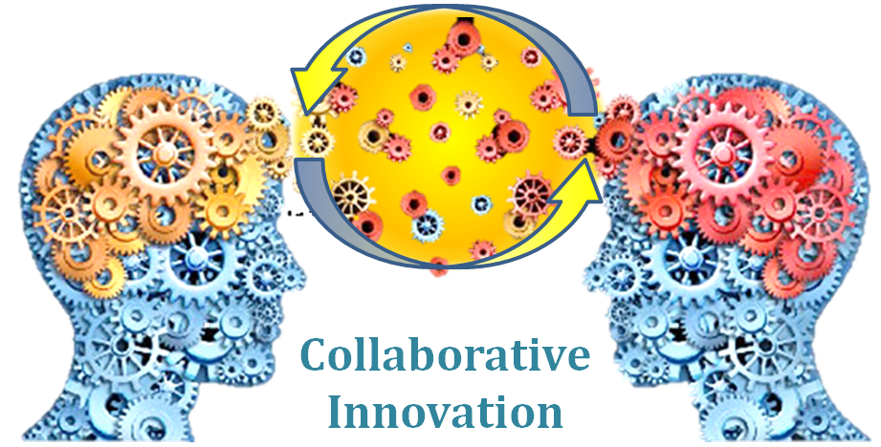
Innovation architecture
innovation
culture
➔ Culture Architecture makes a fluid transition into the Innovation Architecture
Rediscovery of Greek Innovation Engine
ARCHITECTURE
We rediscovered powerful Greek Innovation Methodology requiring years of research.
  Revealed potent framework for unlocking
  Co-Creative Power of Cross-Functional Teams.
Updated and combined with Edison’s creative inquiry, our system is available today to the world.
  It’s replicable and easy to understand….
  And it produces great results, but only in
  high trust, high collaboration cultures.
Transforms Diversity of Thinking
into Massive Strategic Asset
Value Delivered ➔ Sustainable Innovation “Engine” | Generate New Value from Existing Resources

Slide 9
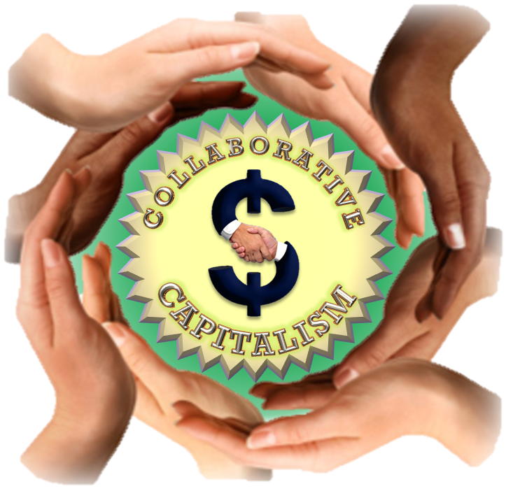
Collaborative Economics Architecture
Economics
innovation
➔ Innovation Architecture makes a fluid transition into the Economics Architecture
Profitable Economic Engine for Value Creation
ARCHITECTURE
Creates high levels of Productivity
Uses Trust & Innovation to reduce Non-Value Added Work and reduce cross-boundary inefficiency
Reduces Risk and Litigation by up to 30%
Doubles chances of on-time/budget Project Delivery
Accelerates End-to-End Value Chain competitiveness
Turns Breakdowns into Breakthroughs
Generating 10-25% better return on human capital
Value Delivered ➔ Sustainable Competitive Advantage | Generate New Value from Entire Value Chain

Slide 10
Leadership Architecture
Leadership
Economics
→ Economic Architecture makes a fluid transition into the Leadership Architecture
ARCHITECTURE
4-Dimensional Alignment
Our Most Enabling Breakthrough
Dynamic Realignment
Leadership has traditionally been agglomeration
of styles, traits, characteristics, and habits.
➔This Level of Thinking is Not Effective -- suboptimal
Our breakthrough is Reframing leadership as an Integrated System of Four Alignments
  Like playing “4-Dimensional Chess”
  Enables Collaborative Excellence
  Fast to Implement , Easy to Learn, Rapid Returns
  Nearly impossible for competitors to duplicate
  Synergy Source Code – the unfulfilled quest of leaders for centuries – only manifests in Aligned Systems
Adversity
Crisis
Opportunity
Strategic
Operational
Alignment
Alignment
Cultural
T i m e
Comp
Alignment
ion
it
et
C hange
Value Delivered ➔ Synergistic System Producing Massive Advantage & Employee Engagement

Slide 11
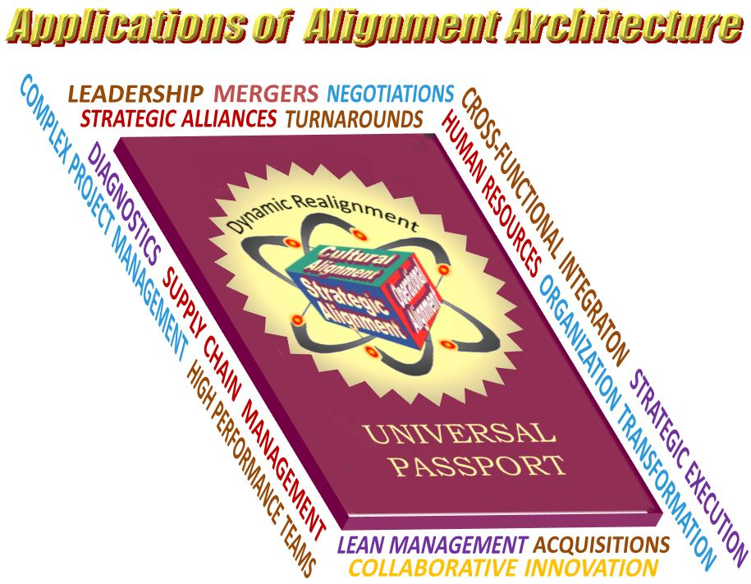

applications of Alignment
Architecture
Leadership
Economics
innovation
culture
➔Six
Architectures
become a
Systems
Framework
for Organization
Transformation
(see Appendix)
Trust
Human drives
ARCHITECTUREs

Slide 12
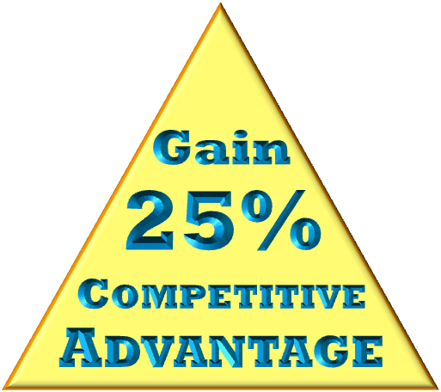
Organizational impact
Leadership
Economics
Six Integrated Collaborative Architectures Produce 25% Greater Competitive Advantage
  Increased Communications
  Increased Trust & Teamwork
  Increased Employee Retention
  Increased Problem Solving
  Increased Innovation
  Increased Speed & Flow
  Increased Value Creation
  Increased Performance
  Increased Productivity
  Increased Profitability
innovation
culture
Trust
Human drives
ARCHITECTUREs

Slide 13
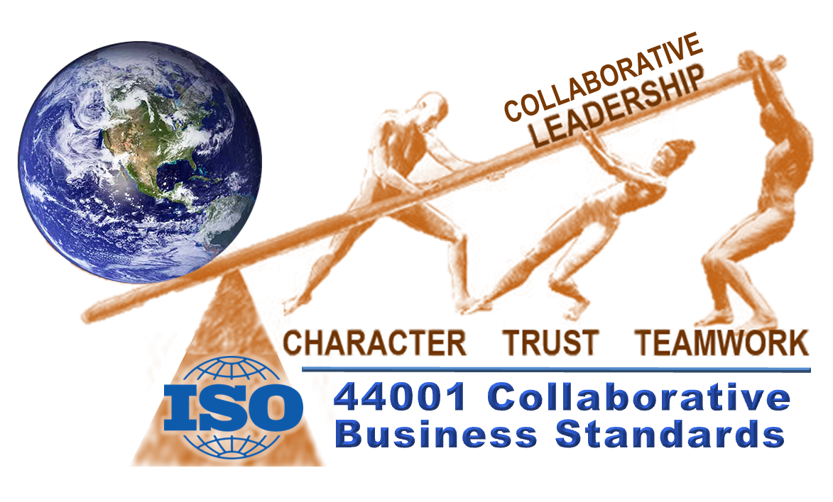
Global impact
Collaborative Excellence
Aimed at Elevating the Capabilities of Leadership
OBJECTIVE:
Use Collaborative Leadership and
ISO Collaborative Standards leverage to:
Elevate the Course of History,
the Destiny of Nations
and
the Fate of People

Slide 14
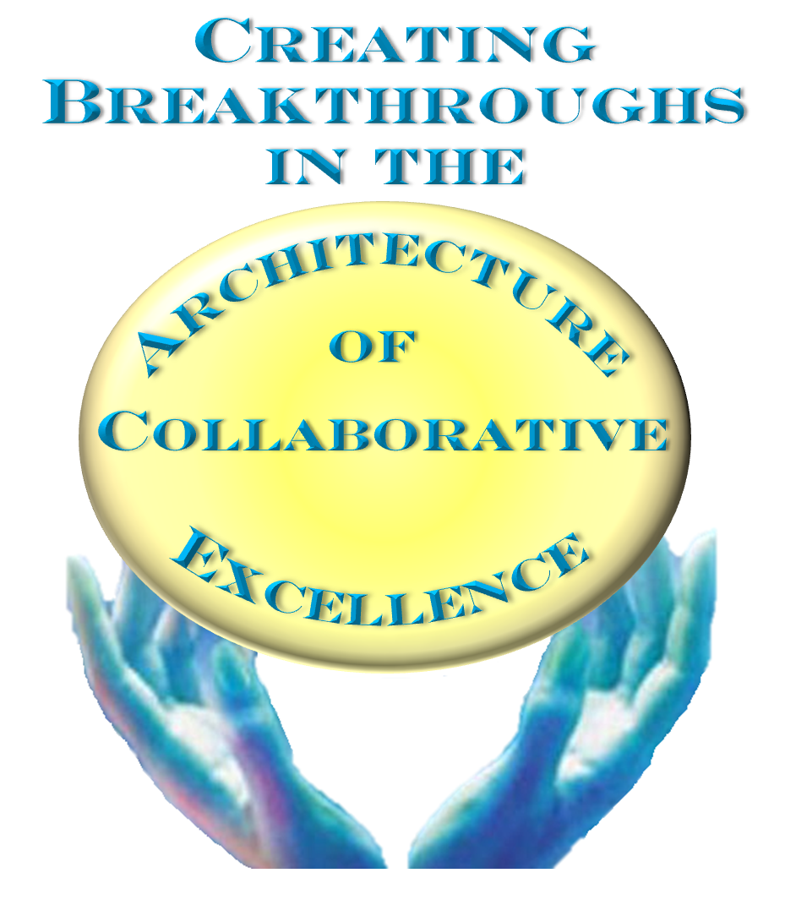
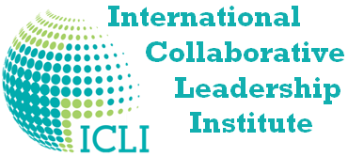
Our Dedication
The Institute is dedicated to advance Collaborative Excellence among Leaders across the world.
Effective leadership is at the core of all great organizations and civilizations.
Trusted leaders produce the greatest levels of teamwork, innovation, and productivity, resulting in superior competitive advantage.
See www.ICLInstitute.org to learn more

Slide 15
APPENDIX
Confidential
Transformation
System

Slide 16
Organization Transformation System
Two Fundamental Strategies to Manage Complexity
Simplify -- Transactional
Integrate -- Collaborative
Simplify
(take out unnecessary complexity)
Specialize
(functional/technical focus)
(Multiple Specializations needs more integration, else silos)
Synergize
(Align, Balance, Build Trust & Better Teamwork between units, use differential innovation)
Synchronize
(coordinate, interactive speed, integrate)
Doing All Four Together requires enablement of:
  Prediction/Forecasting (to anticipate future demands)
  Leadership (to provide better Guidance System into the future)
  Innovation (to adapt to change)
  Speed & Efficiency (to better utilize resources)
  Building Right Capabilities (to provide competencies & character -- training & education)
  Coordinated Delivery (to integrate & synchronize/synergize -- Internally and Value Chains

Slide 17
Using the Four Alignments for
Organization Transformation
◆ Strategic Alignments:
Co-Create an Inspirational Common Vision,
then chart an Innovative Course that
generates a Significant Advantage
or Improvement over mediocre alternatives.
◆ Cultural Alignments:
Leaders build a Culture, Relationships &
Governance of Trust that Unleashes & Focuses
Human Energy to Synergize Achieving Strategies.
◆ Operational Alignments:
Build Coherent Organizational Teams,
with Accountability, Measures of Success,
& Rewards that produce great results.
◆ Dynamic ReAlignment:
Innovate & Adapt & Reconfigure as conditions change
Dynamic Realignment
Adversity
Crisis
Opportunity
Strategic
Operational
Alignment
Alignment
Cultural
T i m e
Comp
Alignment
ion
it
et
C hange
Note: Enables Rapid Diagnostics & Categorization of all Data

Slide 18
Transformation Framework
1) Strategic Alignment
Compelling Rationale (Logic)
  Requirement to Adapt/Change
  (Dynamic ReAlignment)
  Gap between Today’s Reality
  and Tomorrow’s Requirement
  Measure of the Magnitude of the Gap
Urgency (Emotion)
  Sense of Urgency to avert Danger
  or Unfulfilled Need (i.e. Customer Need)
  or Threat of Extinction (slow or fast)
  Broad Action/Timing Required to avert Danger
Clear Vision, Value Proposition
  Precise “picture” (vision) of new approach (framed in the 4 Alignments)
  Value Proposition that inspires & specifies what will be delivered by when
Strategic Pathway & Action Required
  Strategy to Win vs Competition – Extend to entire Value Chain, including Suppliers, Delivery Partners, and Customers (now & future)
  Specific Goals & Targets, Measures of Success
  Innovation Required (technical, process, integration, etc.)

Slide 19
Transformation Framework
2) Cultural Alignment
Leadership United
  Strong Voices aligned/united in their call to action
  Can-Do Attitude with emphasis on a Spirit of Teamwork, Trust, & Innovation
  Use of the Influence of Authority & Peer Groups
  Willingness to Change voiced by those “in the know”
  Identify “Champions” (who believe in the Strategy) to Execute
  Ensure Champions have Executive Sponsors (“godfathers”)
  Empowerment of Key People & Influencers1
Foundational Culture of Trust & Teamwork
  Ensure Collaborative Leadership Style to provide spirit, handle complexity (only collaborative leadership can generate synergy)
  Continuous Emphasis on Integrity of Actions & Words
  Ensure change is Safe, Secure, Fair, Honorable, and Ethical
  Engage those who will be part of the new strategy in developing its implementation before announcement (refine strategy to ensure success)
  People Support What They Help Create
  Constant Communications about the Strategy, Rationale, and Culture needed to Achieve the Strategy -- Focus on Teamwork as the means to achieve the Strategy (beware – only the right type of communications)
  Ensure Human Resources have Capability (capacity & competence)

Slide 20
Transformation Framework
2) Cultural Alignment
Address Resistance to Change
    Engage Stakeholders & Power Bases
    Build Trust & High Performance Teamwork
    Training Programs – New Attitudes, Skills & Capabilities
    Lower the Threshold of Risk & Fear – Positive Adversity Response
    Define New Standards of Behavior
    Simplify the Transition -- complexity kills transformation
    Release Non-Performers, Cynics, Resisters
    Clean up cultural snags
    Transform Conflict into Innovation (using Dynamic Differential Energy)
    Communicate Frequently with open feedback loops

Slide 21
Transformation Framework
3) Operational Alignment
  Transform Strategic Intent & Value into Adaptable Projects
  Strategic Initiative must become a system-wide Project with tangible Deliverables, Milestones, Roles, Responsibilities, and Accountability
  Select Collaborative Project Leaders who understand 4 Alignments
  Ensure Adaptability at local level to account for local variation
  (Don’t Micro-Manage)
  Turn Breakdowns into Breakthroughs with Learning & Innovation
  Emphasize Collaborative Innovation, Excellence, & Team Performance
  Devise Pilot Projects to Create Rapid Evidence and Belief
  Focus on Best Collaborative Practices
  Preselect Champions & Team Players
  Beware of TransActional Short-Comings of Project Management
  Gain Traction with Quick Wins
  – Pilot Projects
  (Give the Healthy Skeptics something to deny the Negative Cynics)
  Develop Key Learnings for use in larger projects
  Show where it (or parts of it) worked or failed and why (conditions for success)

Slide 22
Transformation Framework
4) Dynamic ReAlignment
  Identify Potential Breakdowns
  85% of all Breakdowns are Predictable
  Most Breakdowns occur at points of flux or interfaces
  Turn Breakdowns into Breakthroughs – Learning & Collaborative Innovation
  Use Collaboration to Adapt to Changes in Environment & Manage Complexity
  Institute Fastime Processes
  Remover Non-Value Added
  Streamline Process Flow, Remove Silos/Barriers
  Ensure Cross-Functional Alignment & Teamwork
  Create Feedback Loop to Strategic Planning
  Initiate Field-Scanning Process
  (see around corners & the horizon)
  Early Warning System to Detect Changes/Shifts in External Environment
  Determine if ReAlignment is Required (reactive, pro-active, pre-active)
  Form Alliances to Gain Early Insight/Access/Advantage to shifts
  Collaborative Innovation
  Engage key stakeholders (internal/external – i.e. customers, suppliers, partners)
  Use Collaborative Innovation Best Practices to maximize potential
  Use Diversity & Trust to generate ideas that morph into better solutions
  Test ideas in pilot projects to generate learning (no such thing as failure)
  ReAlign Structures, Measures & Rewards
  Ensure Organizational Structures support the new vision & value delivery
  Ensure new metrics & rewards match the new vision and behavior|
  (old measures must change otherwise old behaviors & thinking will prevail)
  Ensure required results are multi-dimensional (financial, attitudinal, behavioral, creative, etc.) (Use Balanced Scorecard – Strategic Return on Investment for Strategic Initiatives)
  Reward & Recognize individuals & teams that produce right results the right way

Slide 23
Applications for
Alignment Architecture

